Slide 1
Current and future service
System maps
8/30/24
Notes:
Note: Project delivery dates in the slides that follow are subject to change.

Slide 2
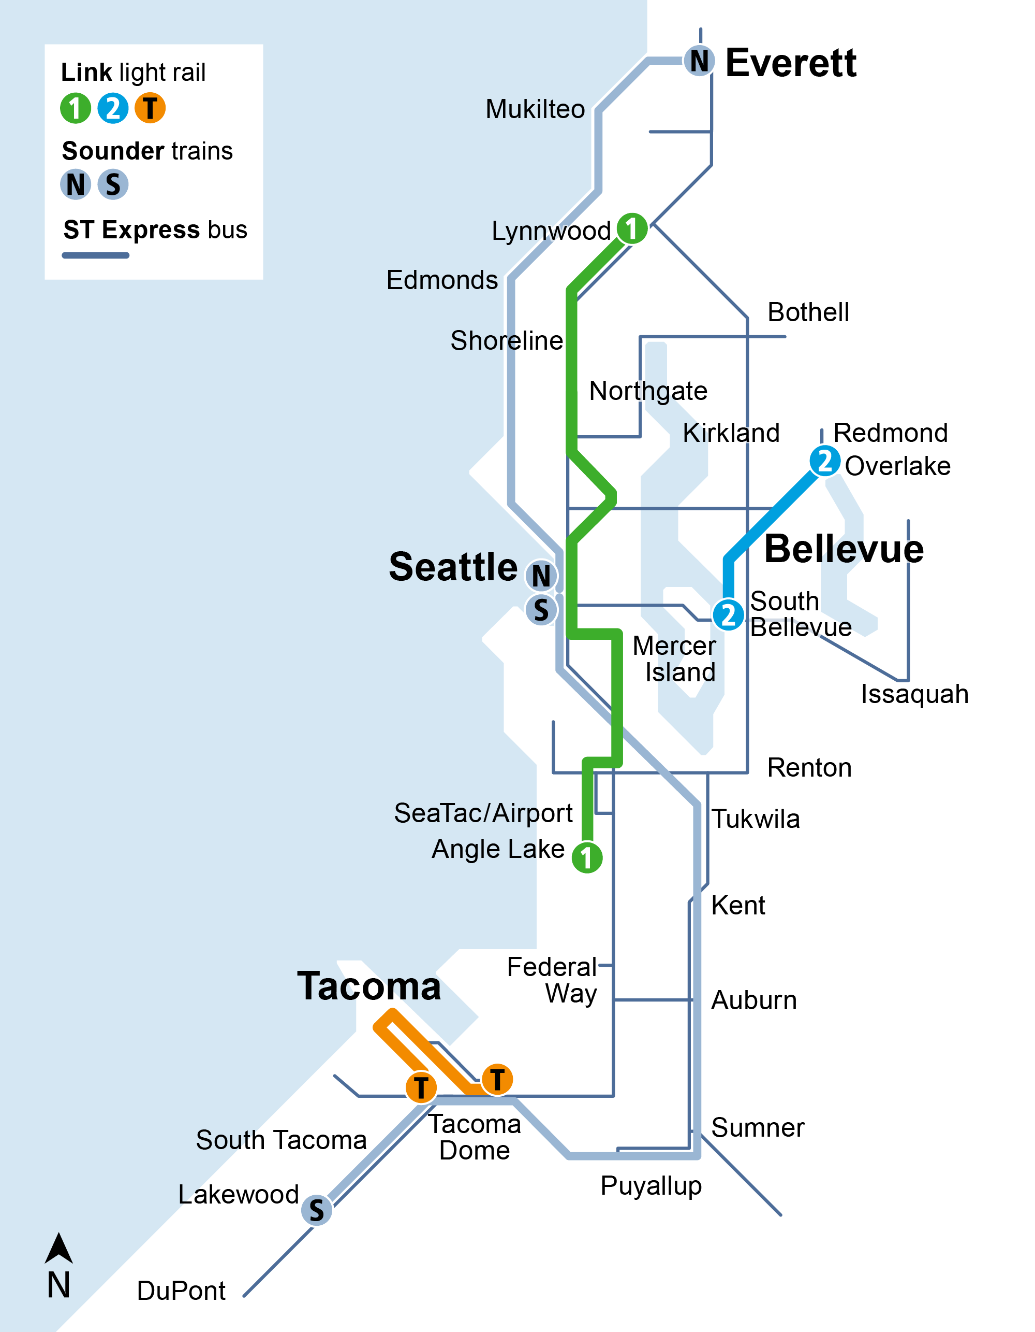





Current system
Link light rail
  Three lines
  44 miles
  44 stations
  Connecting Lynnwood–Angle Lake, Redmond Technology–South Bellevue, Tacoma Dome–St Joseph
Sounder trains
Two lines
83 miles
12 stations
Connecting Everett–Seattle and Lakewood–Seattle
ST Express buses
  24 express routes on regional freeway corridors

Slide 3
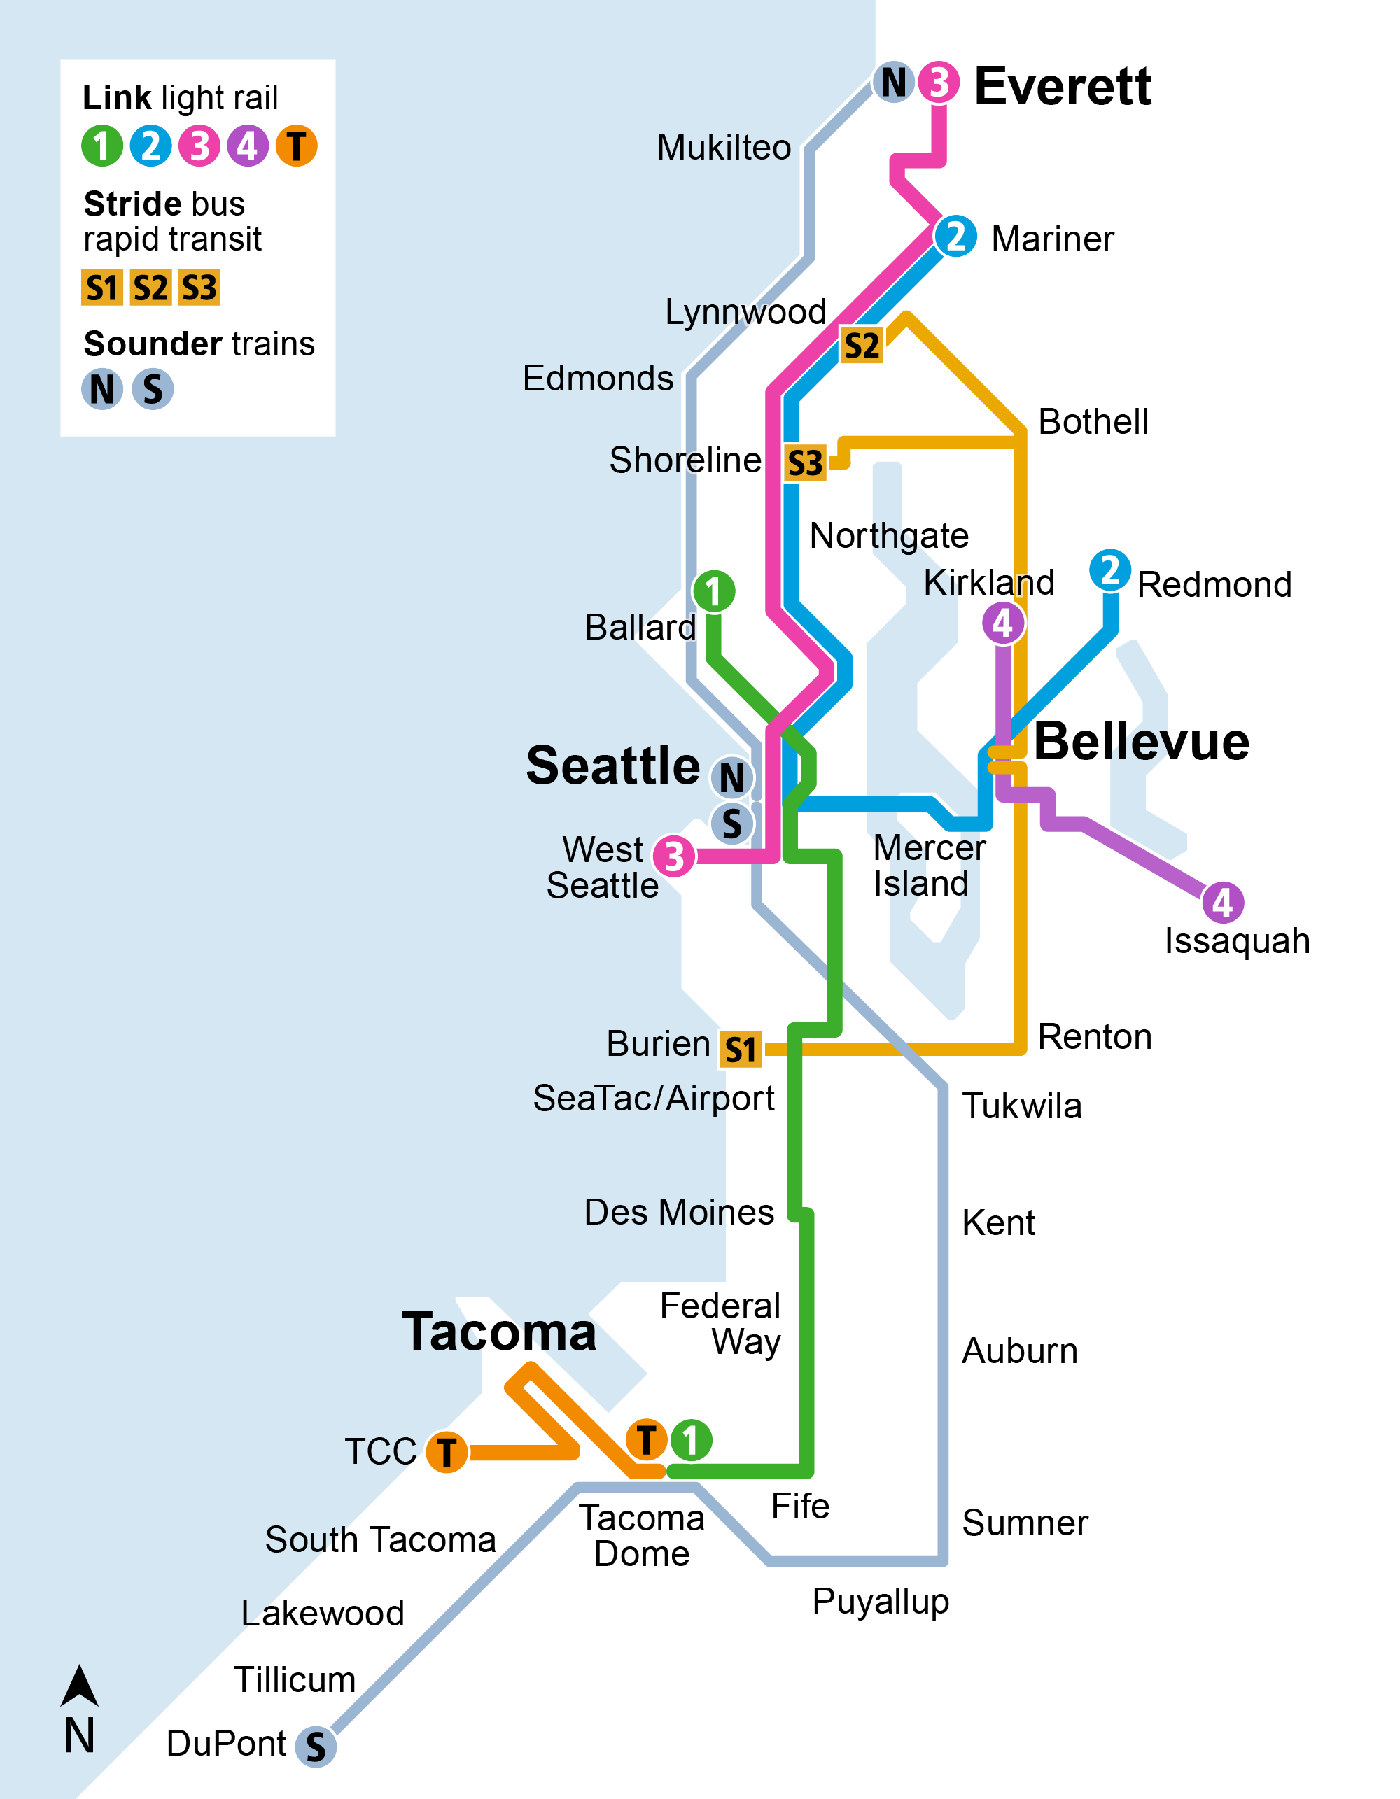





Voter-approved system
Link light rail
  Five lines
  116 miles
  83 stations
Sounder trains
Two lines
91 miles
14 stations
Stride bus rapid transit
  Three lines
  45 miles on I-405 and SR 522
  Serving 12 cities and connecting to light rail in Shoreline, Lynnwood, Bellevue, and Tukwila

Slide 4
ST system maps:
Link, Stride, Sounder
(service opening sequence)

Slide 5
Current system
Link light rail
  Three lines
  44 miles
  44 stations
  Connecting Lynnwood–Angle Lake, Redmond Technology–South Bellevue, Tacoma Dome–St Joseph
Sounder trains
Two lines
83 miles
12 stations
Connecting Everett–Seattle and Lakewood–Seattle
ST Express buses
  24 express routes on regional freeway corridors

Slide 6
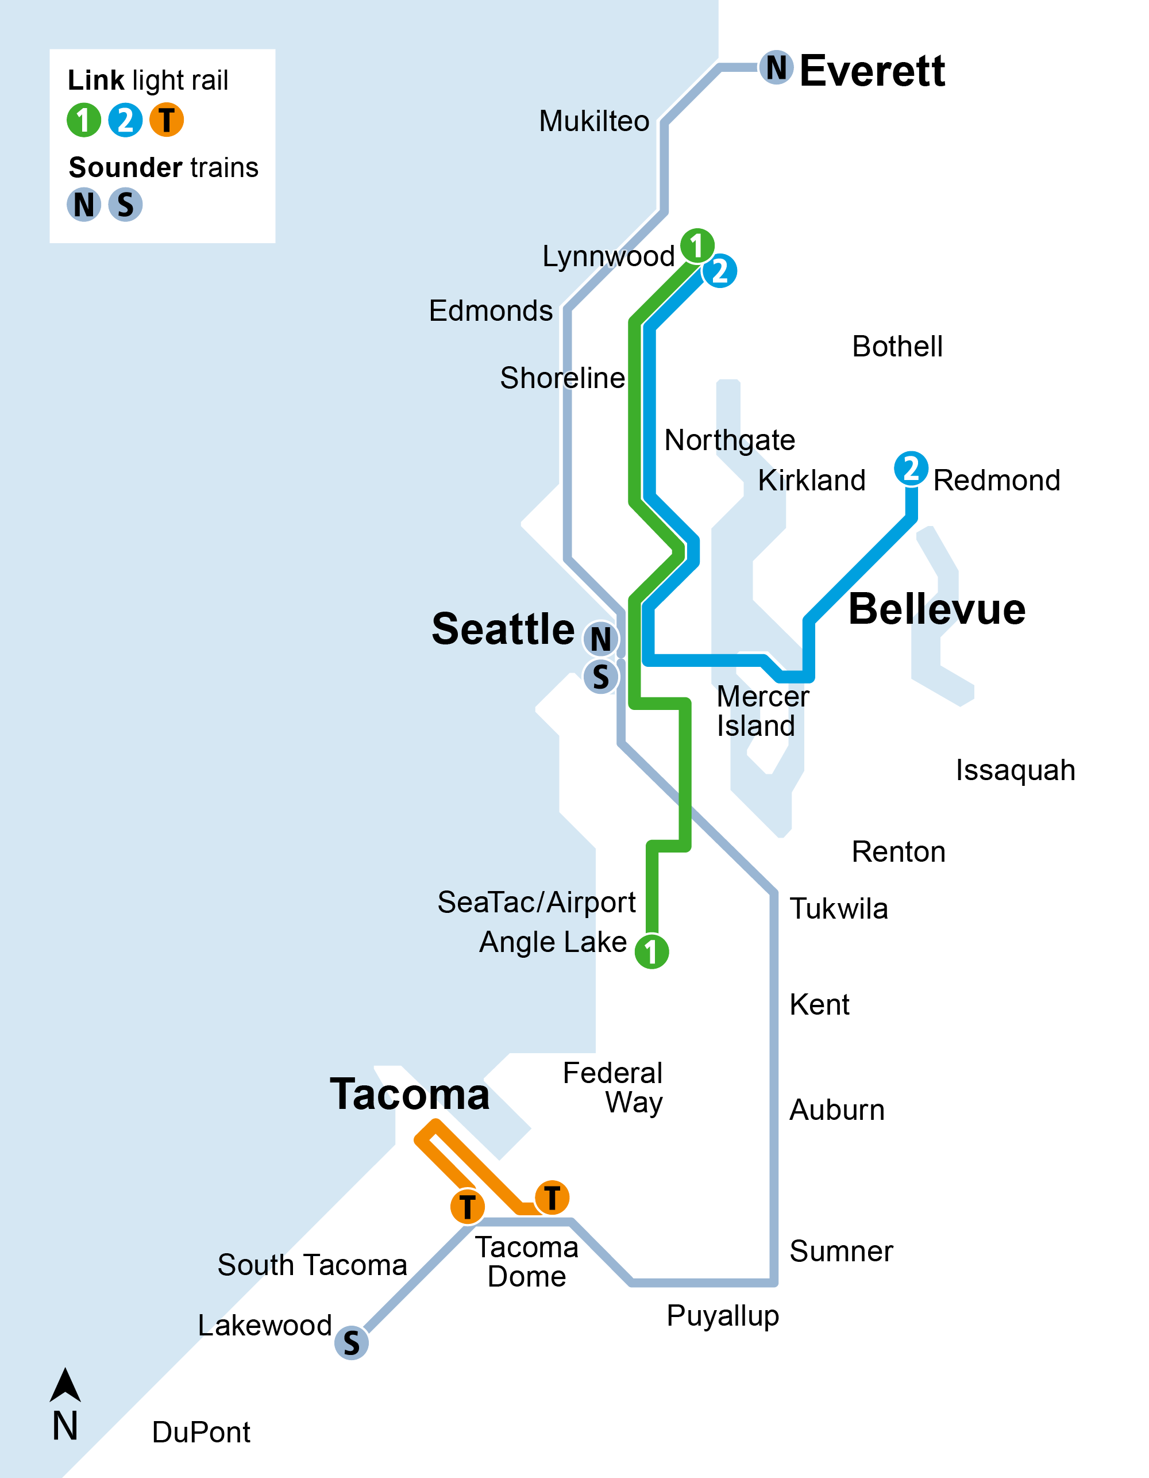
2025
Link light rail
  2 Line connects west to Mercer Island and downtown Seattle, and north to Lynnwood.
  Two new 2 Line stations open serving Marymoor Village near Marymoor Park, and in Redmond’s downtown residential and retail core.

Slide 7
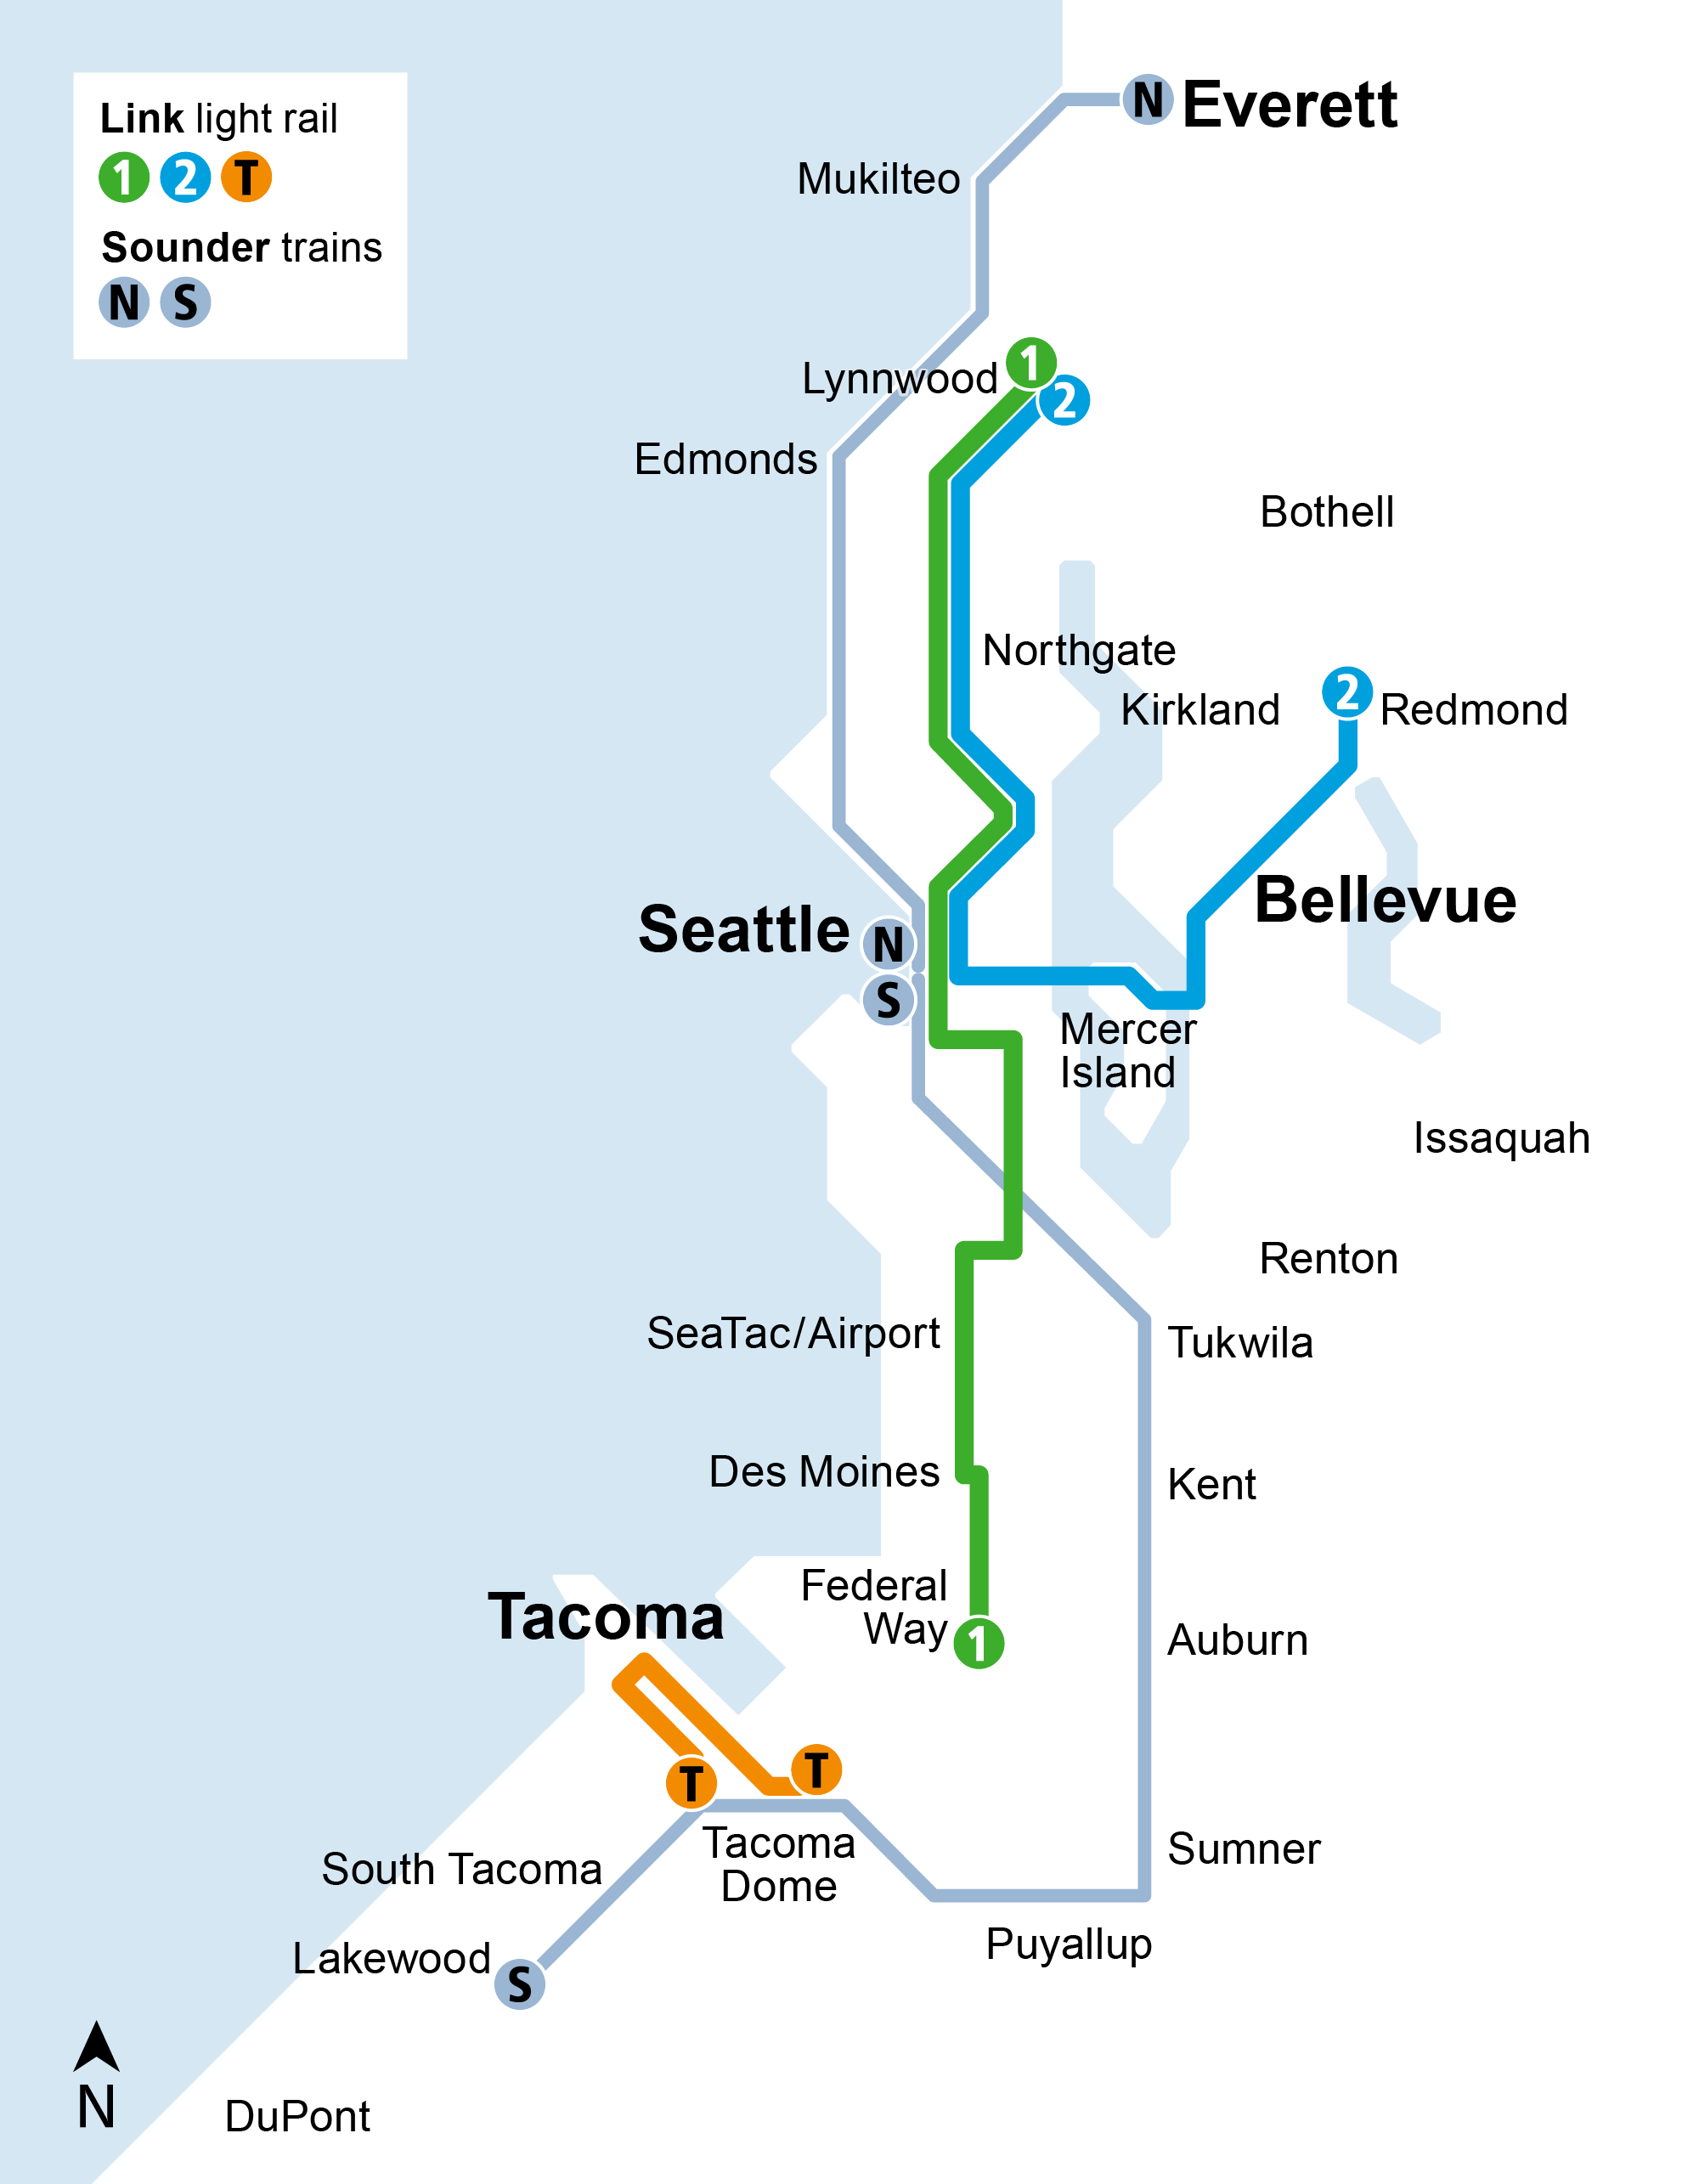
2026–2027
Bus Base North
Link light rail
  1 Line stretches south to serve Kent/Des Moines and Federal Way.
  New station opens at NE 130th Street.
Sounder trains
  2026: New parking garage and access upgrades at Sumner Station.
  2027: New parking garages and access upgrades at Kent and Auburn stations.
NE 130th St
P
P
P
Project schedules and opening dates are subject to change.

Slide 8
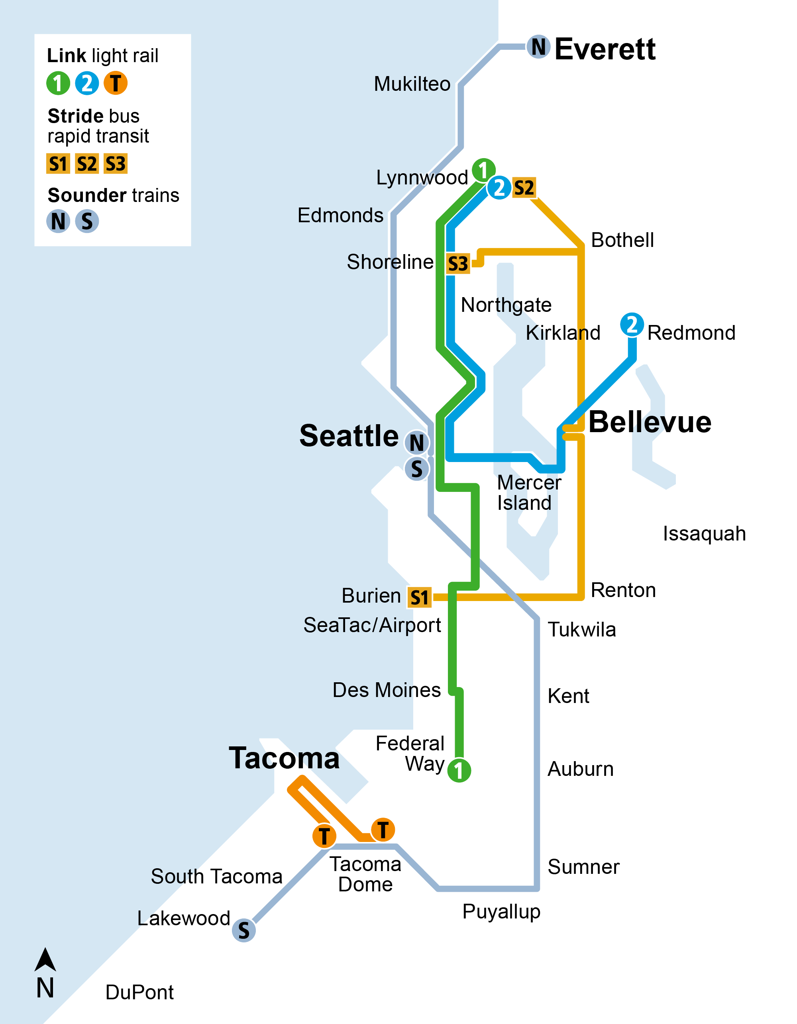
2028–2029
Stride bus rapid transit
  2028: S1 Line launches on I-405, serving Bellevue to Burien and connecting to light rail at Bellevue Downtown and Tukwila International Blvd stations.
  2028: S3 Line opens, serving communities along SR 522 between Shoreline and Bothell and connecting to light rail at Shoreline South/148th Station.
  2028-2029: S2 Line extends north on I-405, serving Lynnwood to Bellevue and connecting to light rail at Lynnwood City Center and Bellevue Downtown stations.

Slide 9
2030–2031
Link light rail
  2031: Two new 1 Line stations open at South Graham Street and South Boeing Access Road.
Sounder trains
  2030: Improved walking, rolling, biking, and transit connections to South Tacoma and Lakewood stations.
Graham St
Boeing Access Rd
+
+

Slide 10
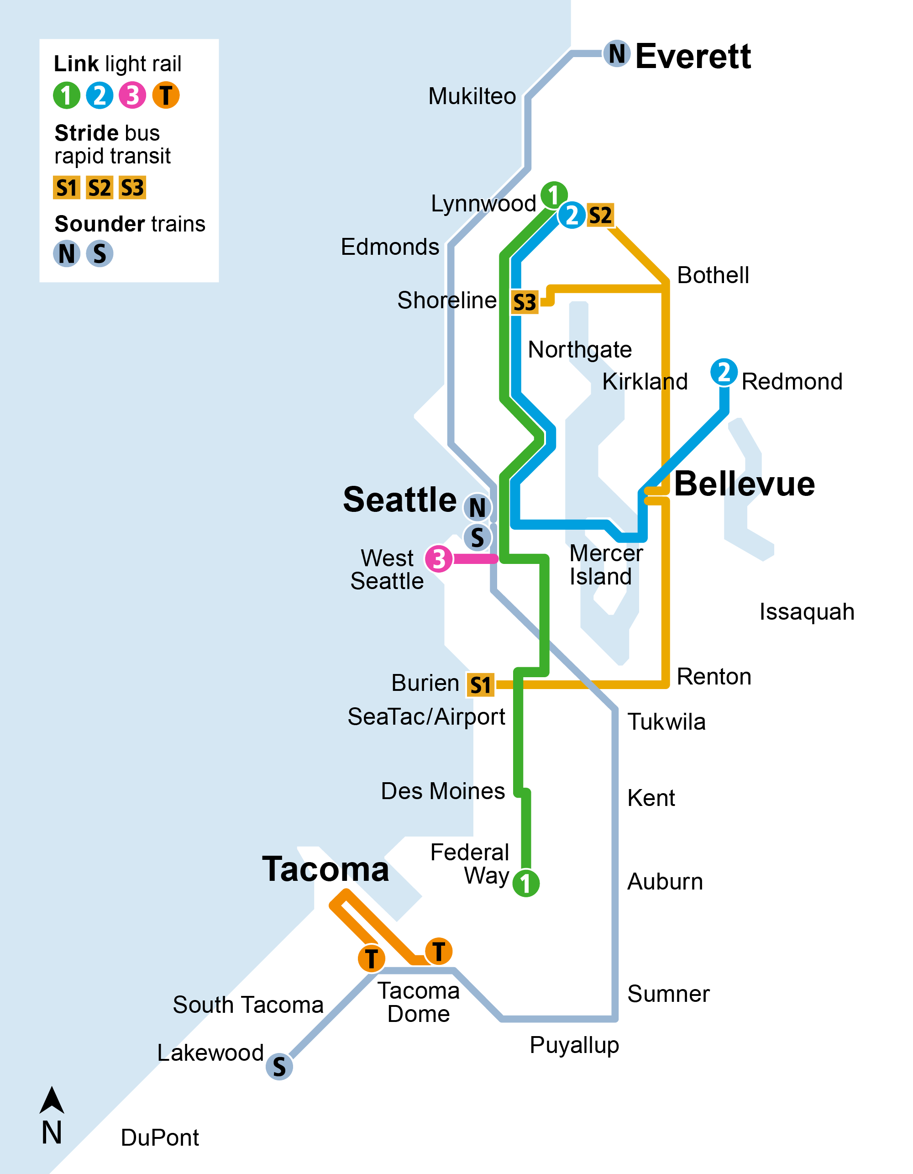
2032
Link light rail
  The 3 Line opens from SODO to
  West Seattle with three new stations.

Slide 11
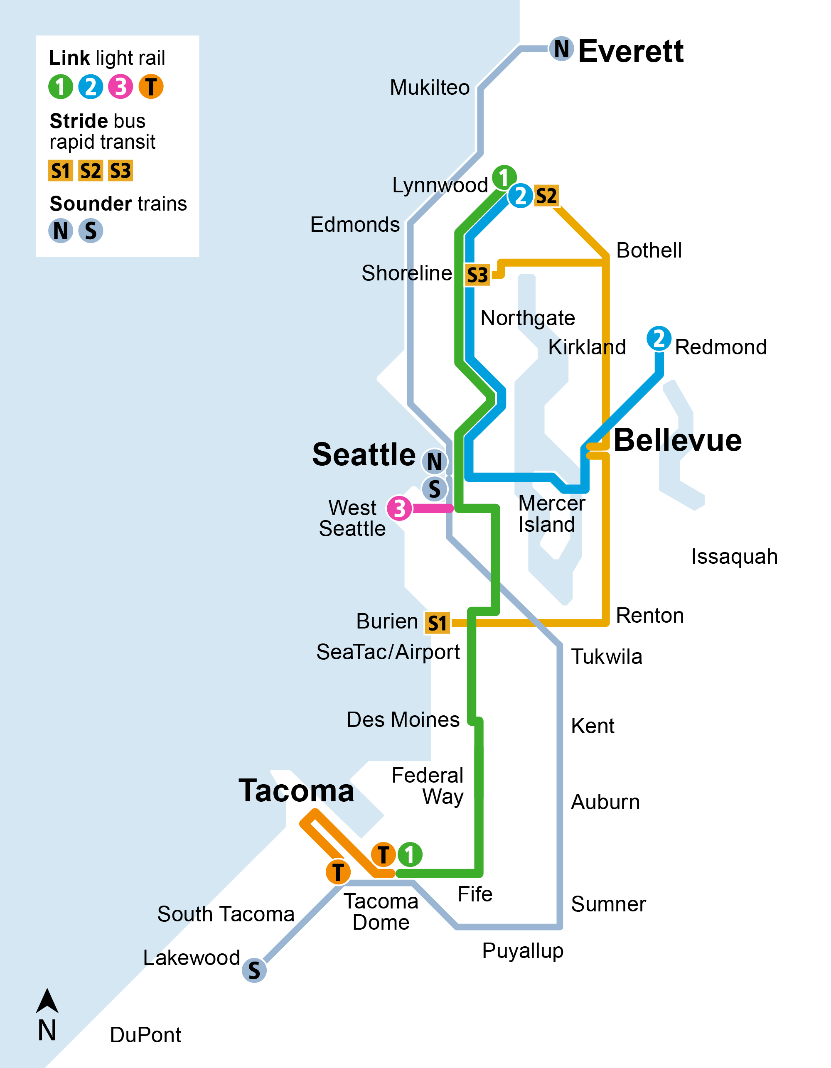
2034-2035
+
Link light rail
  2035: The 1 Line extends to Federal Way, Fife, and Tacoma with four new stations.
Sounder trains
  2034: Parking and access improvements at Edmonds and Mukilteo stations.
+

Slide 12
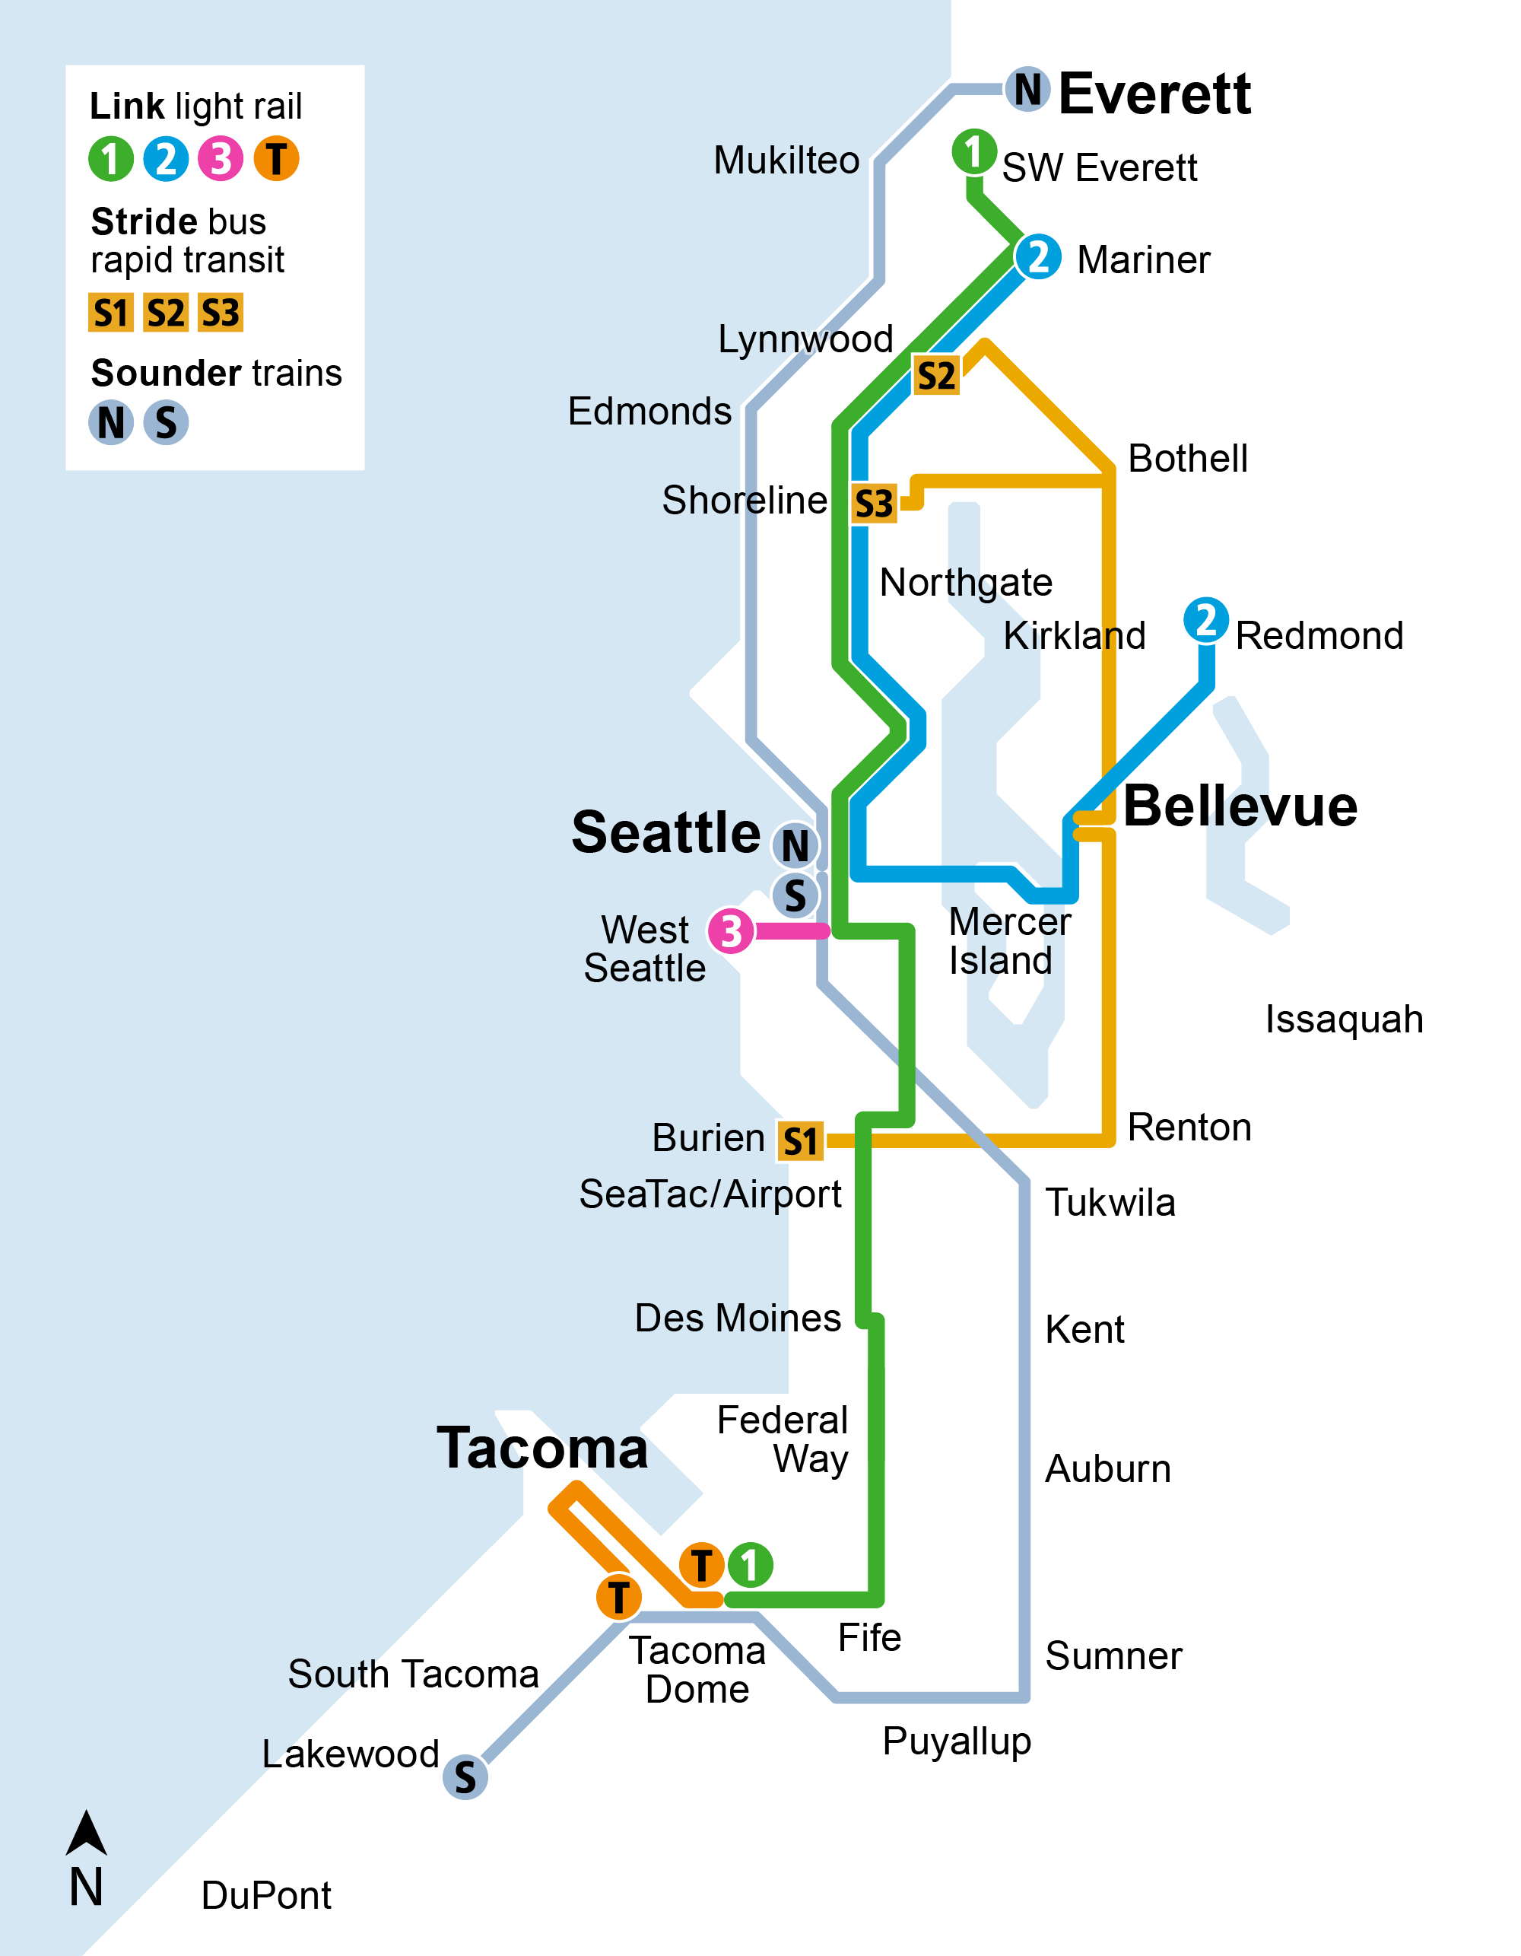
2037
Link light rail
  1 Line and 2 Line service extend to Mariner and SW Everett.

Slide 13
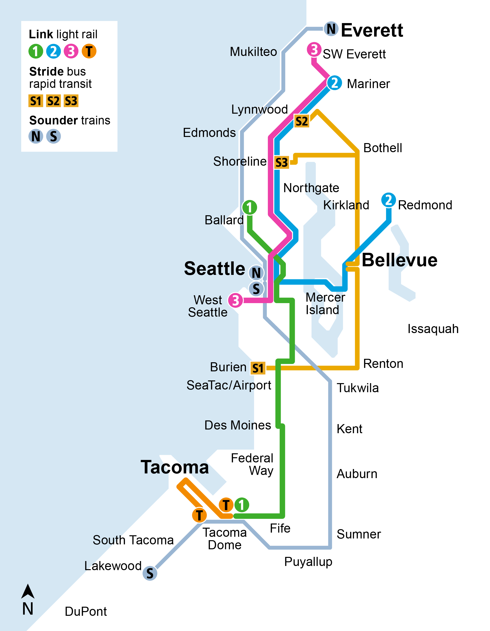
2039
Link light rail
  New downtown Seattle light rail tunnel opens and 1 Line service extends from Ballard to Tacoma.
  3 Line service extends north to SW Everett and connects south to West Seattle.

Slide 14
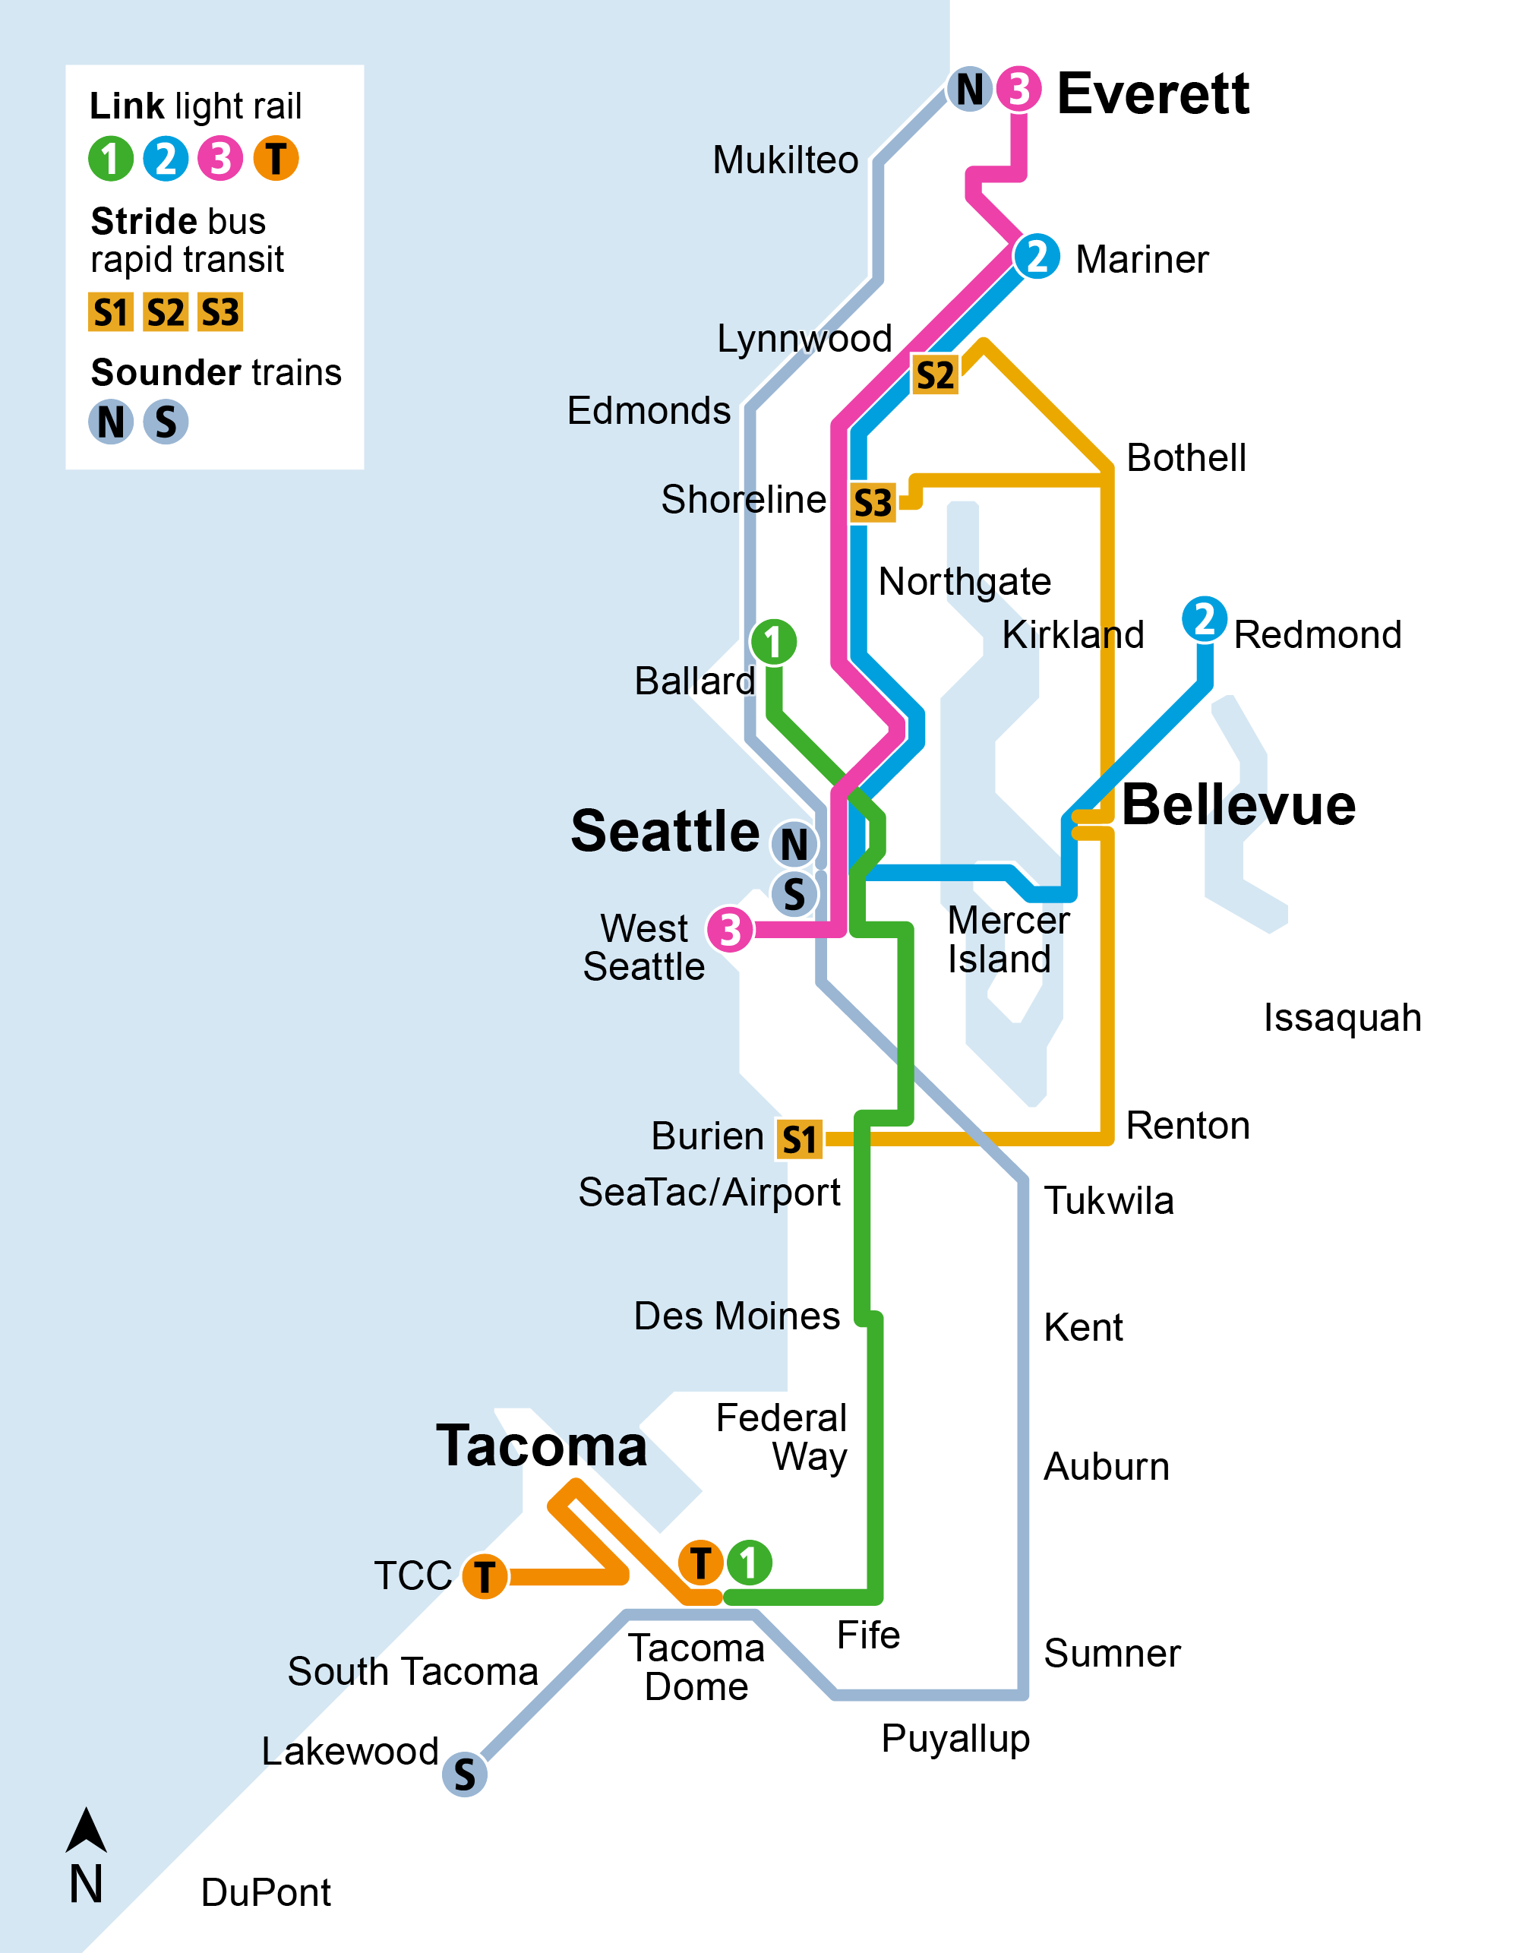
2041
Link light rail
  3 Line service extends north to Everett.
  T Line service adds six more stations and connects to Tacoma Community College.

Slide 15

2044-2045
Link light rail
  2044: The 4 Line opens from South Kirkland to Issaquah with four new stations and 2 Line connections through downtown Bellevue.
Sounder trains
  2045: S Line service extends south with two new stations in Tillicum and DuPont.

Slide 16
Link system maps
(service opening sequence)

Slide 17
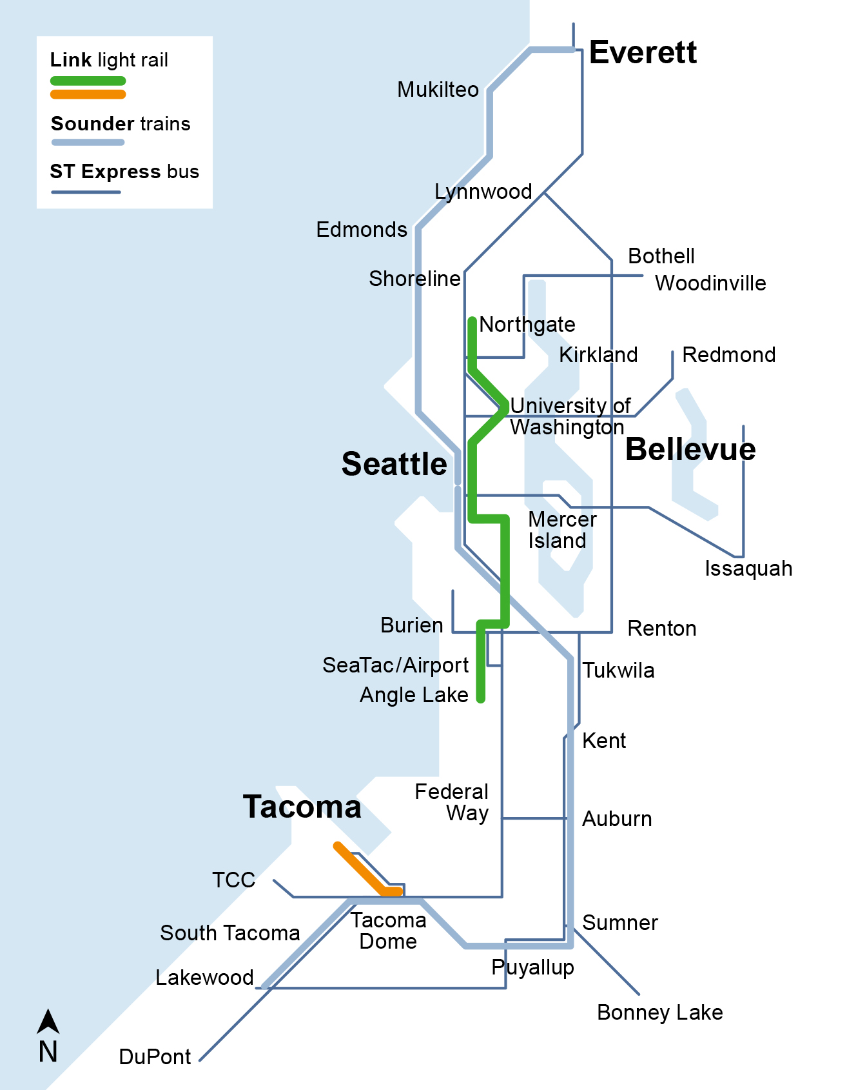
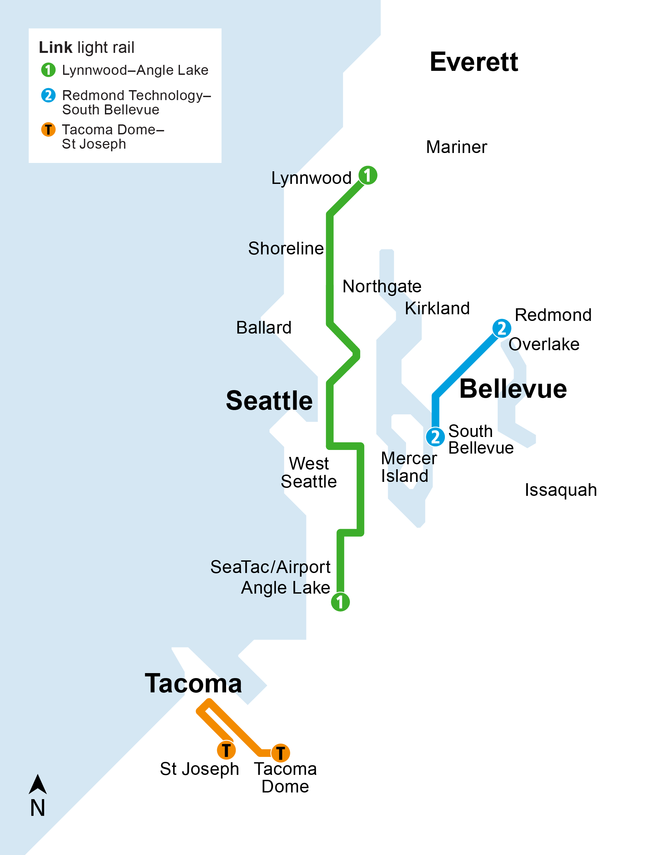
Current system
Link light rail
  Three lines
  44 miles
  44 stations
  Connecting Lynnwood–Angle Lake,
  Redmond Technology–South Bellevue, Tacoma Dome–St Joseph

Slide 18
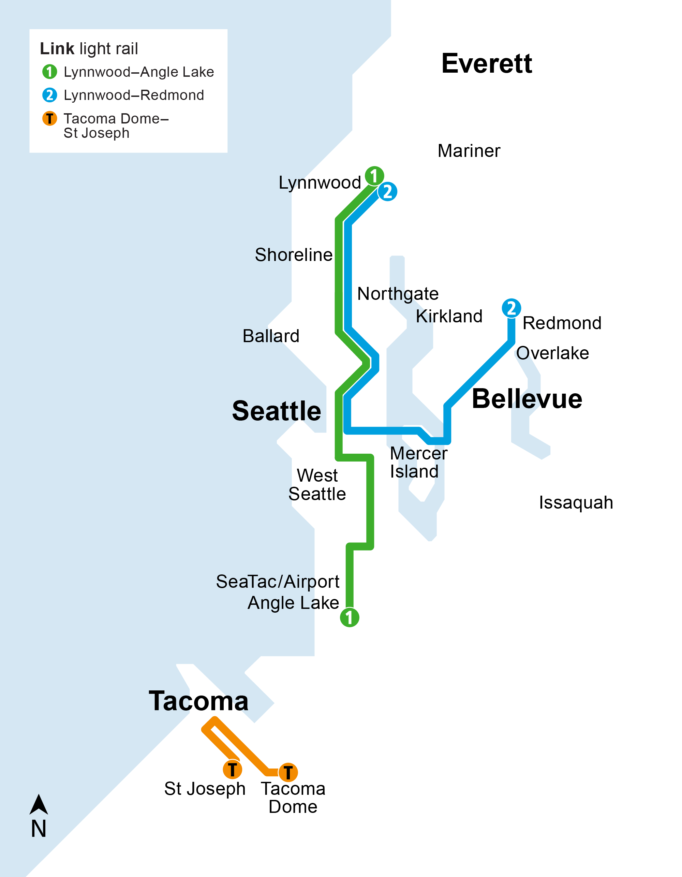
2025
Link light rail
  2 Line connects west to Mercer Island and downtown Seattle, and north to Lynnwood.
  Two new 2 Line stations open serving Marymoor Village near Marymoor Park, and in Redmond’s downtown residential and retail core.

Slide 19
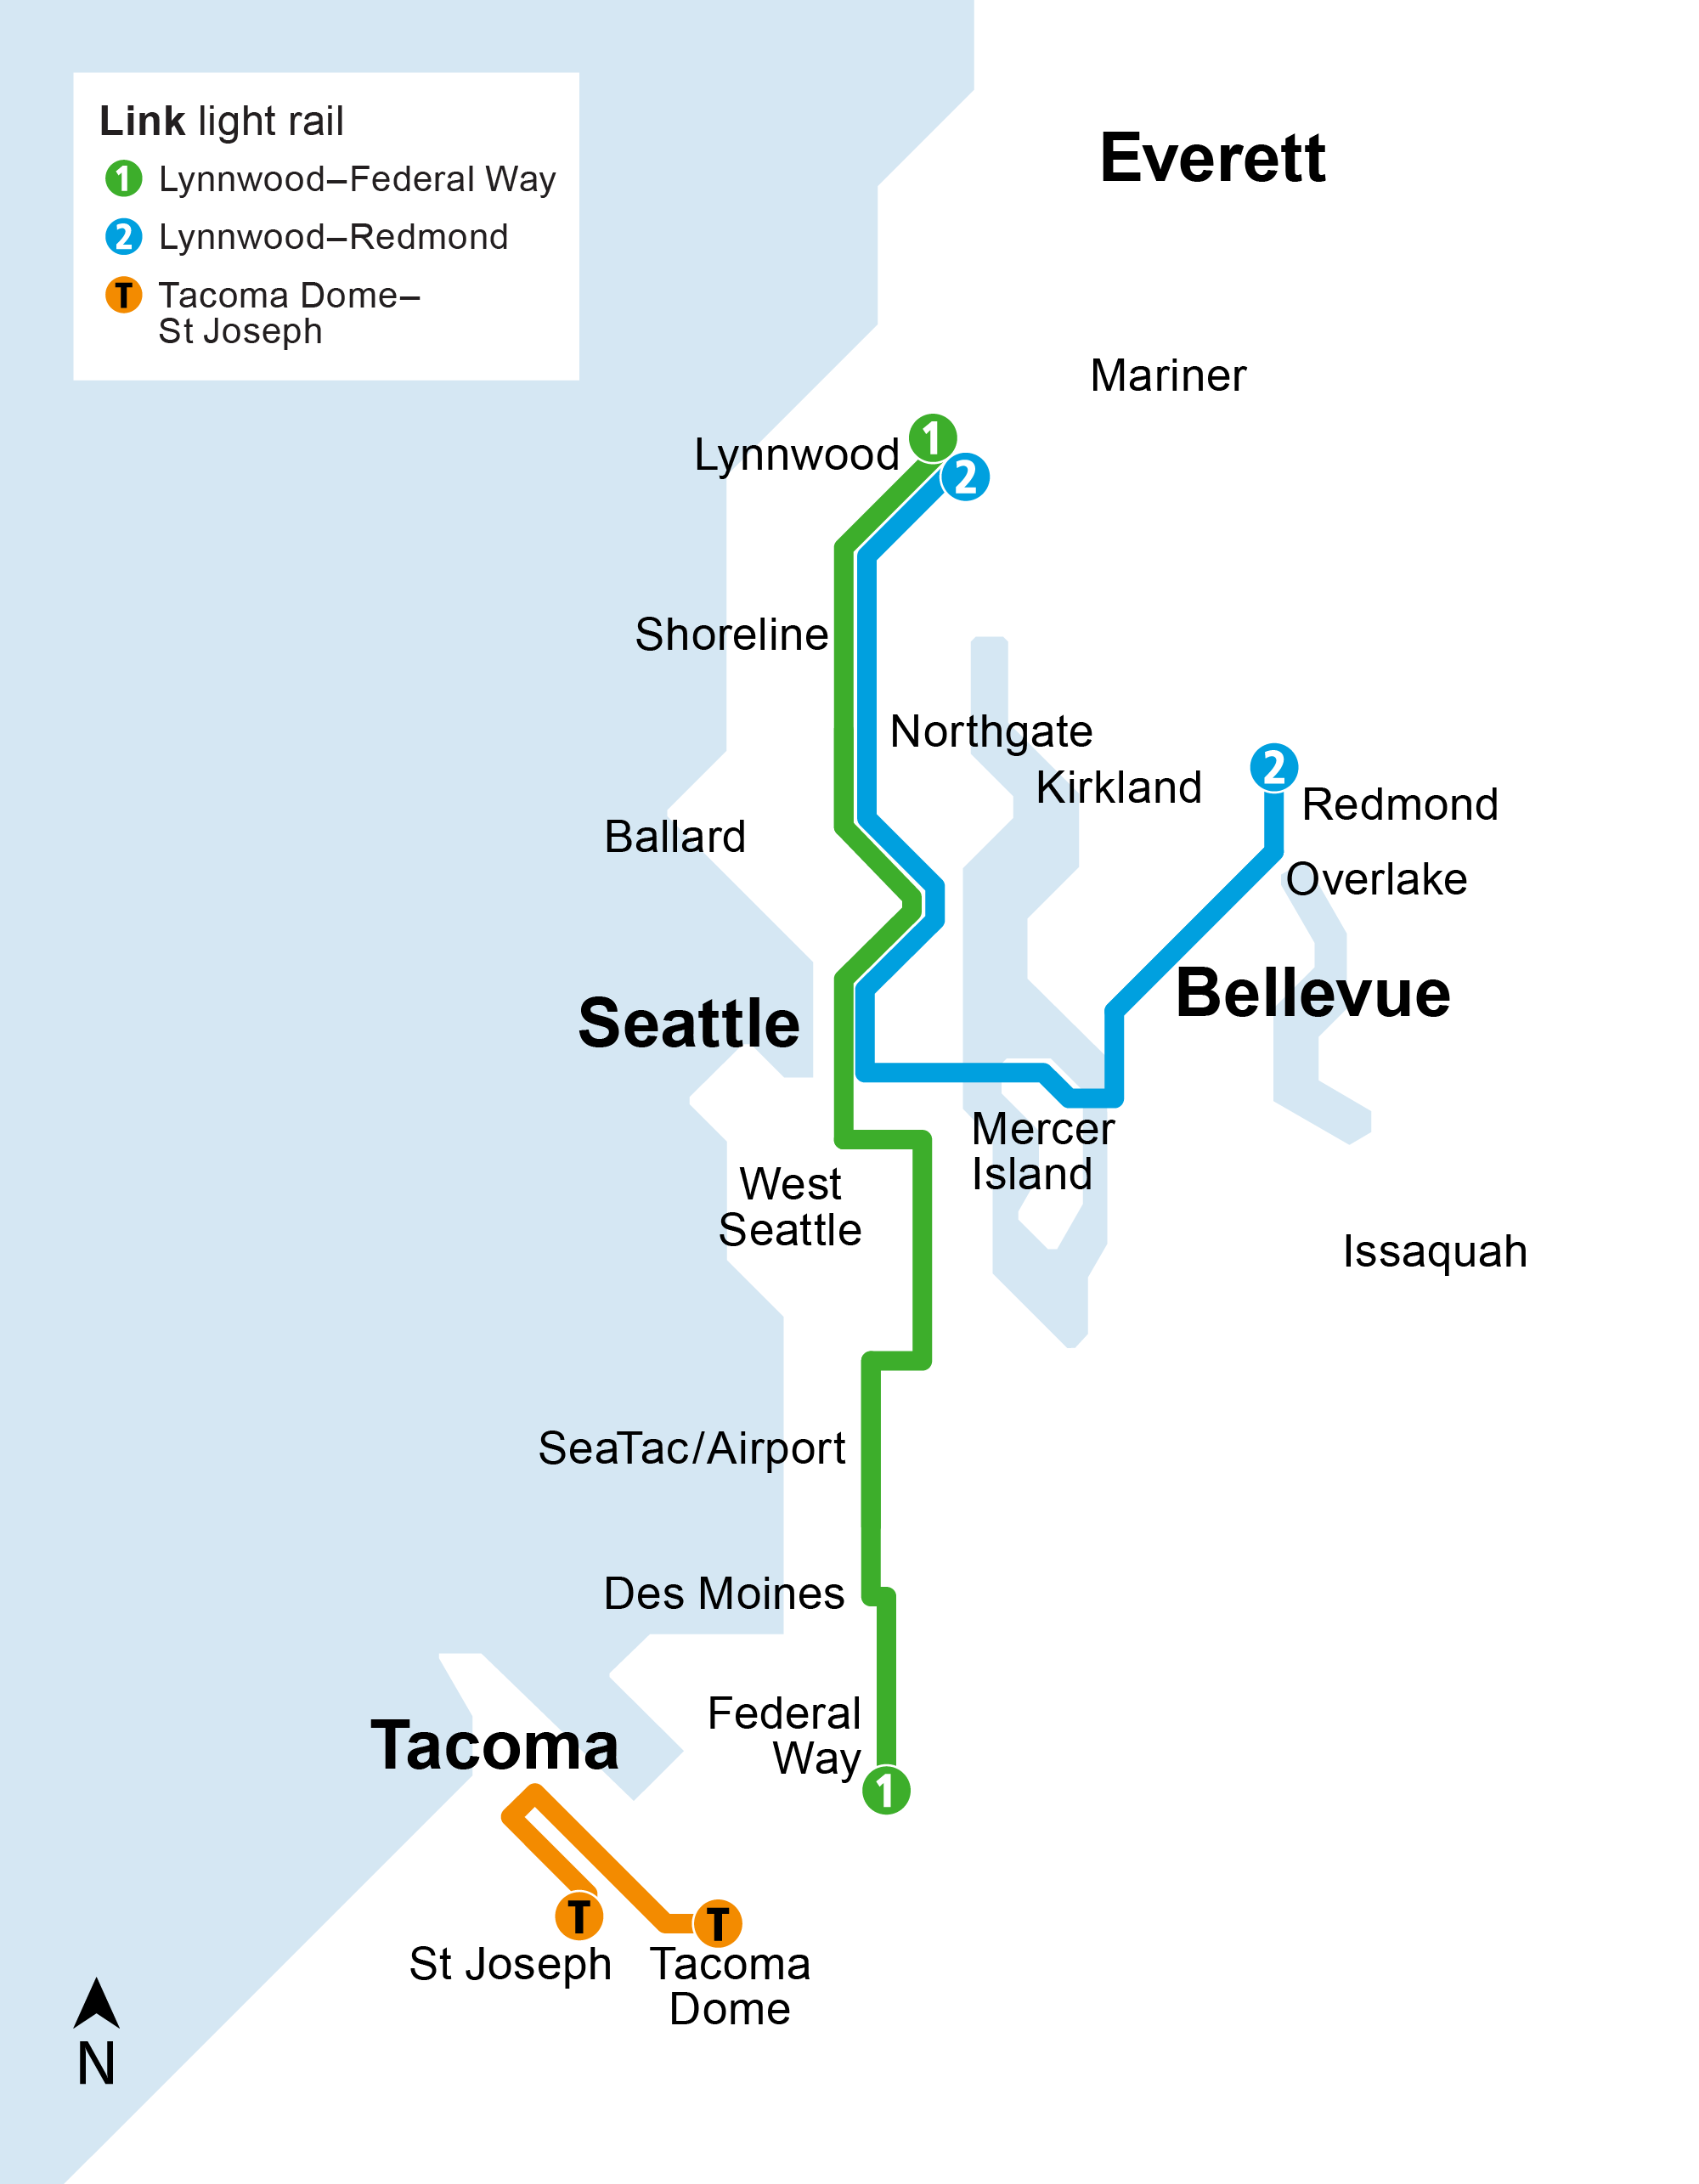
2026
Link light rail
  1 Line stretches south to serve Kent/Des Moines and Federal Way.
  New station opens at NE 130th Street.
NE 130th St

Slide 20
2031
Link light rail
  Two new 1 Line stations open at South Graham Street and South Boeing Access Road.
Graham St
Boeing Access Rd

Slide 21
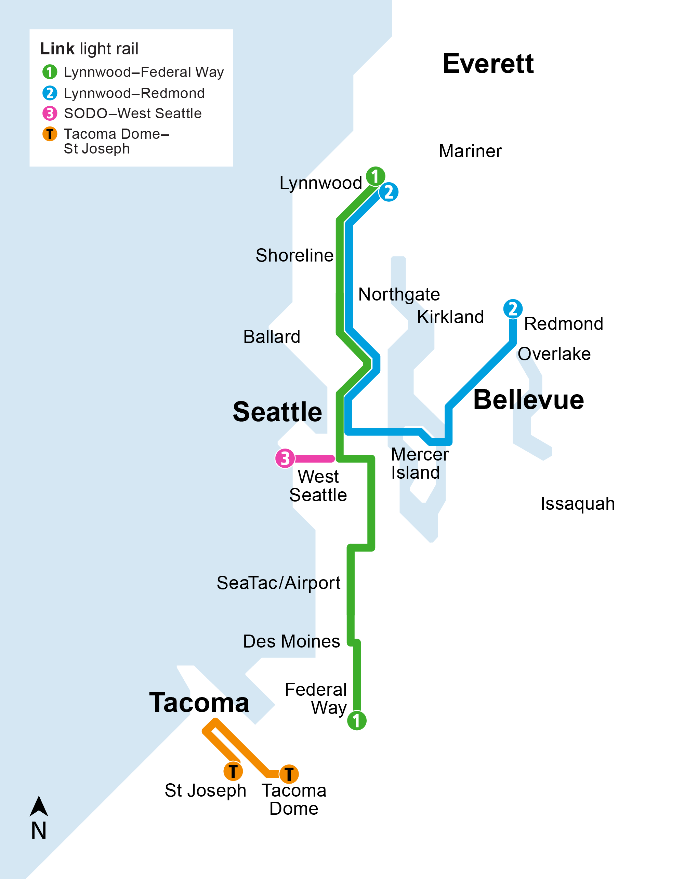
2032
Link light rail
  The 3 Line opens from SODO to
  West Seattle with three new stations.

Slide 22
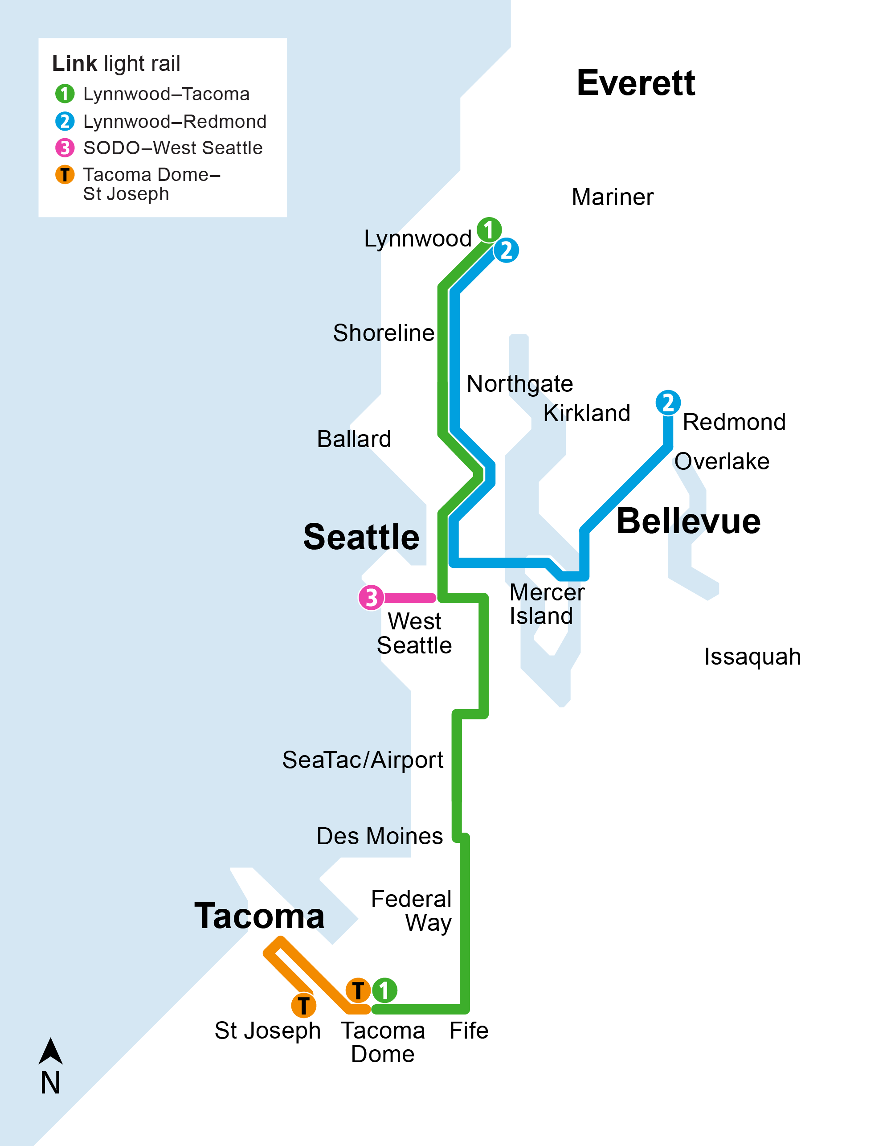
2035
Link light rail
  The 1 Line extends to Federal Way, Fife, and Tacoma with four new stations.

Slide 23
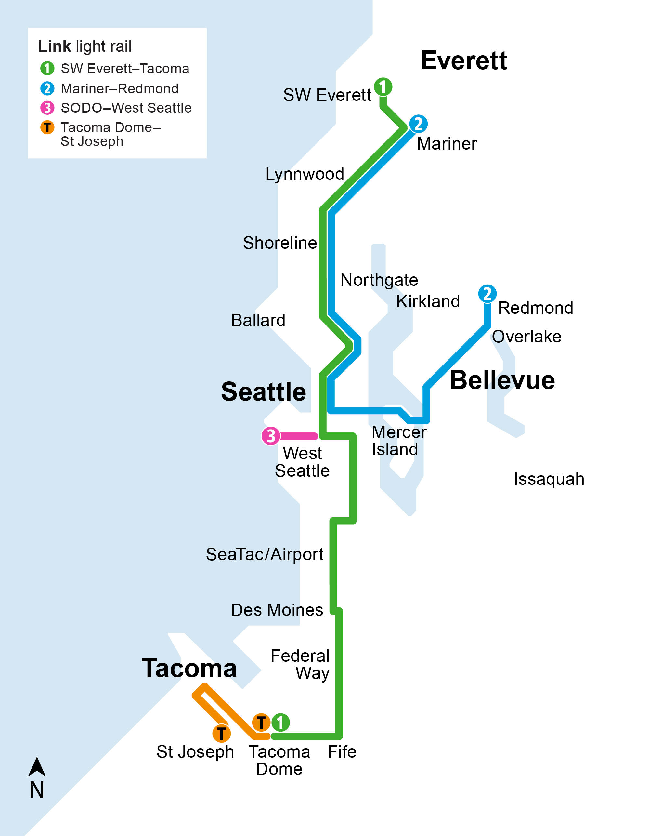
2037
Link light rail
  1 Line and 2 Line service extend to Mariner and SW Everett.

Slide 24
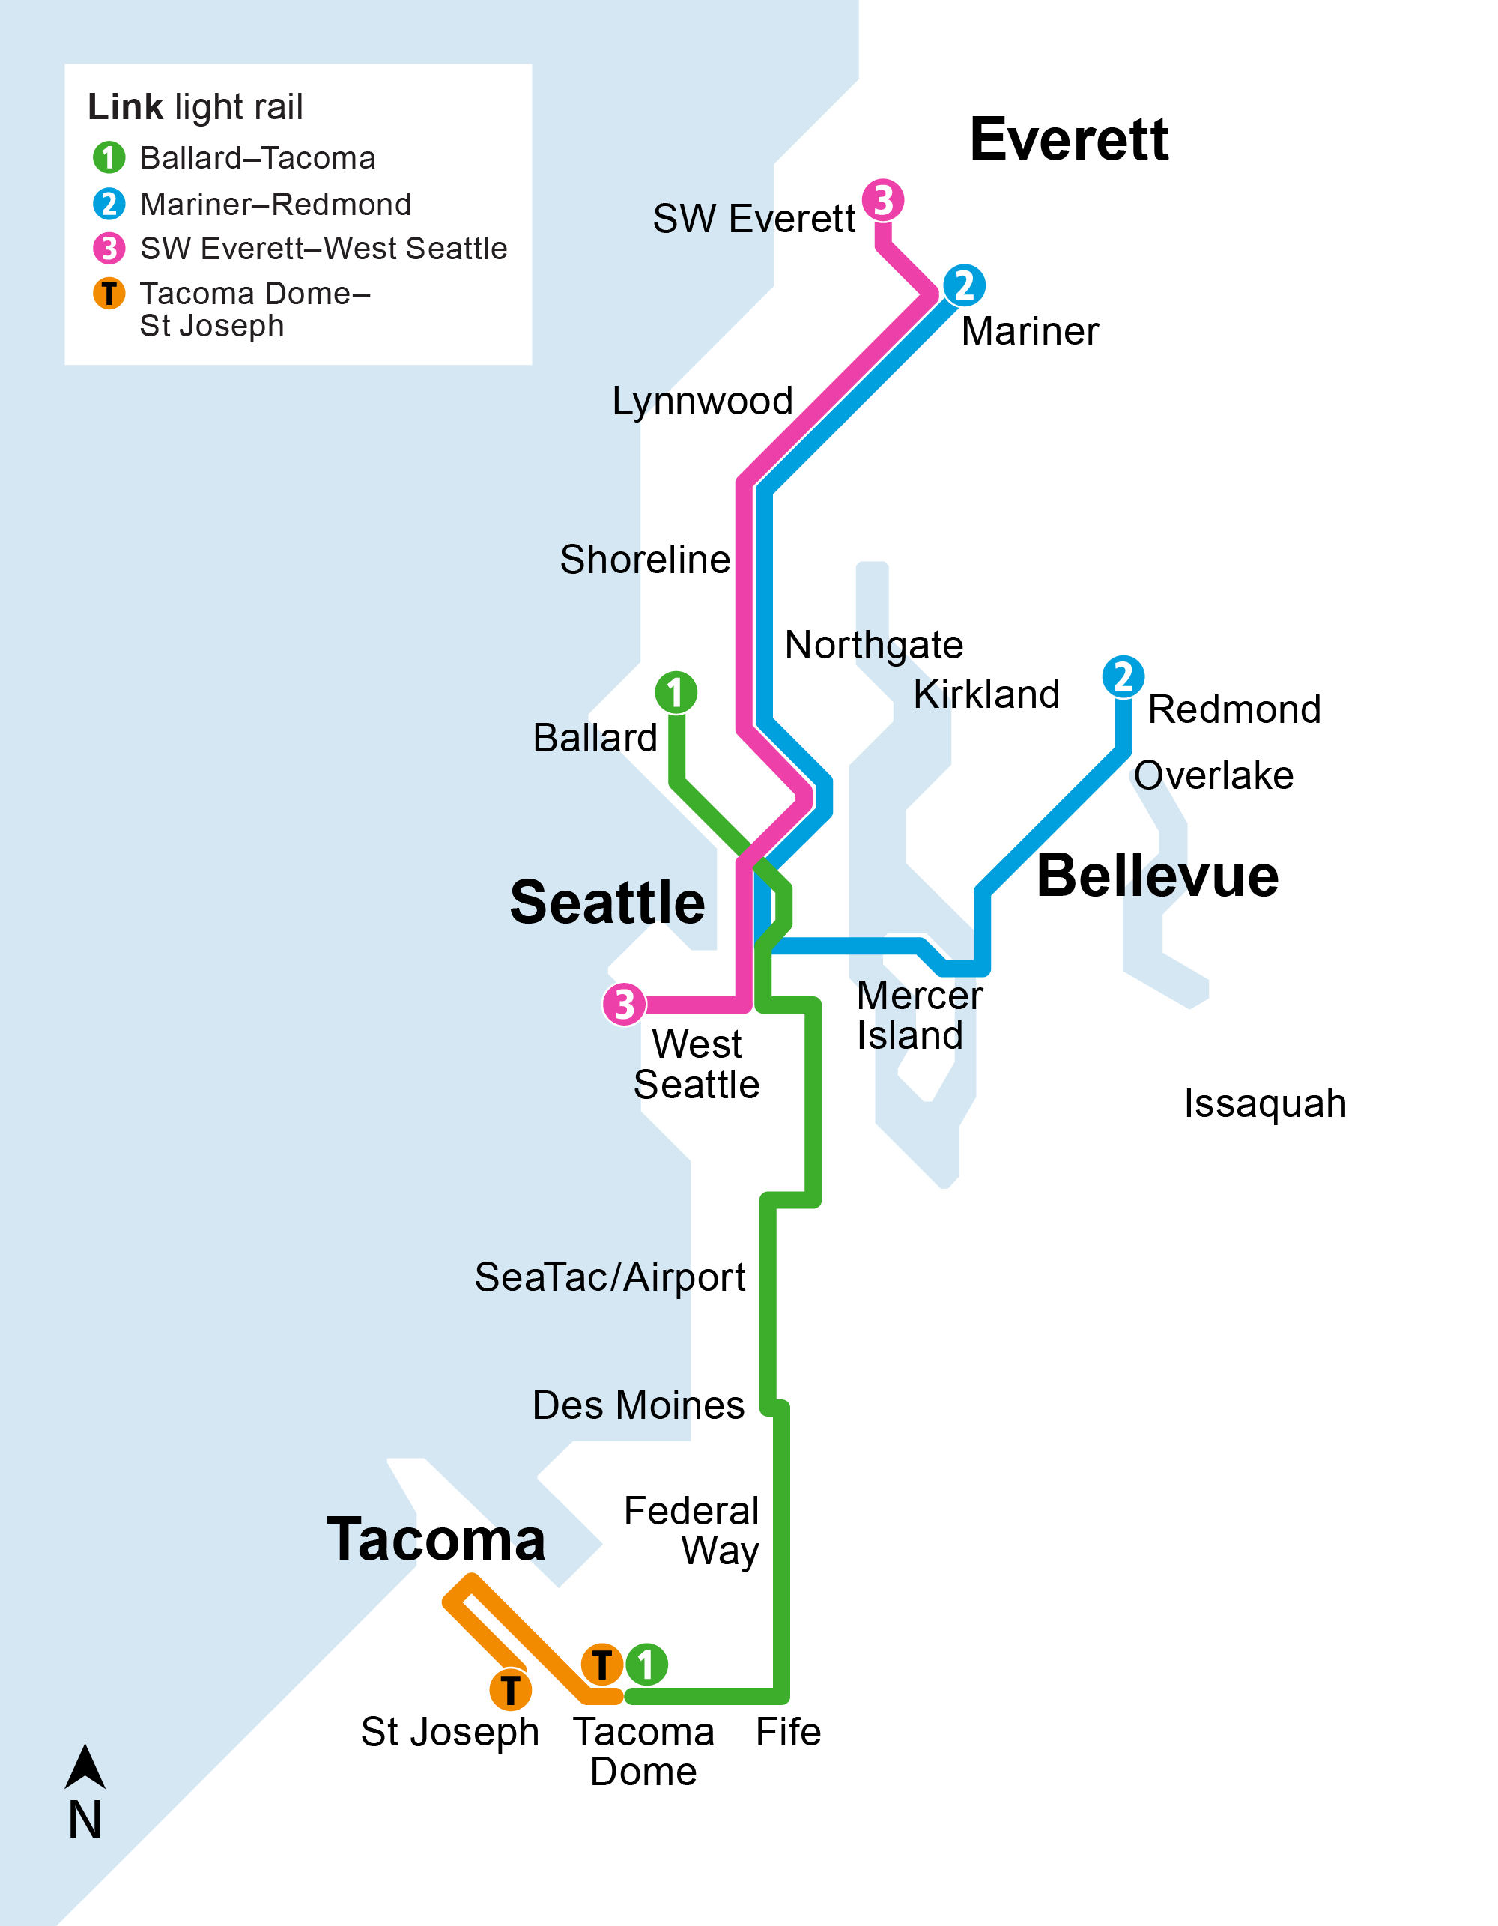
2039
Link light rail
  New downtown Seattle light rail tunnel opens and 1 Line service extends from Ballard to Tacoma.
  3 Line service extends north to SW Everett and connects south to West Seattle.

Slide 25
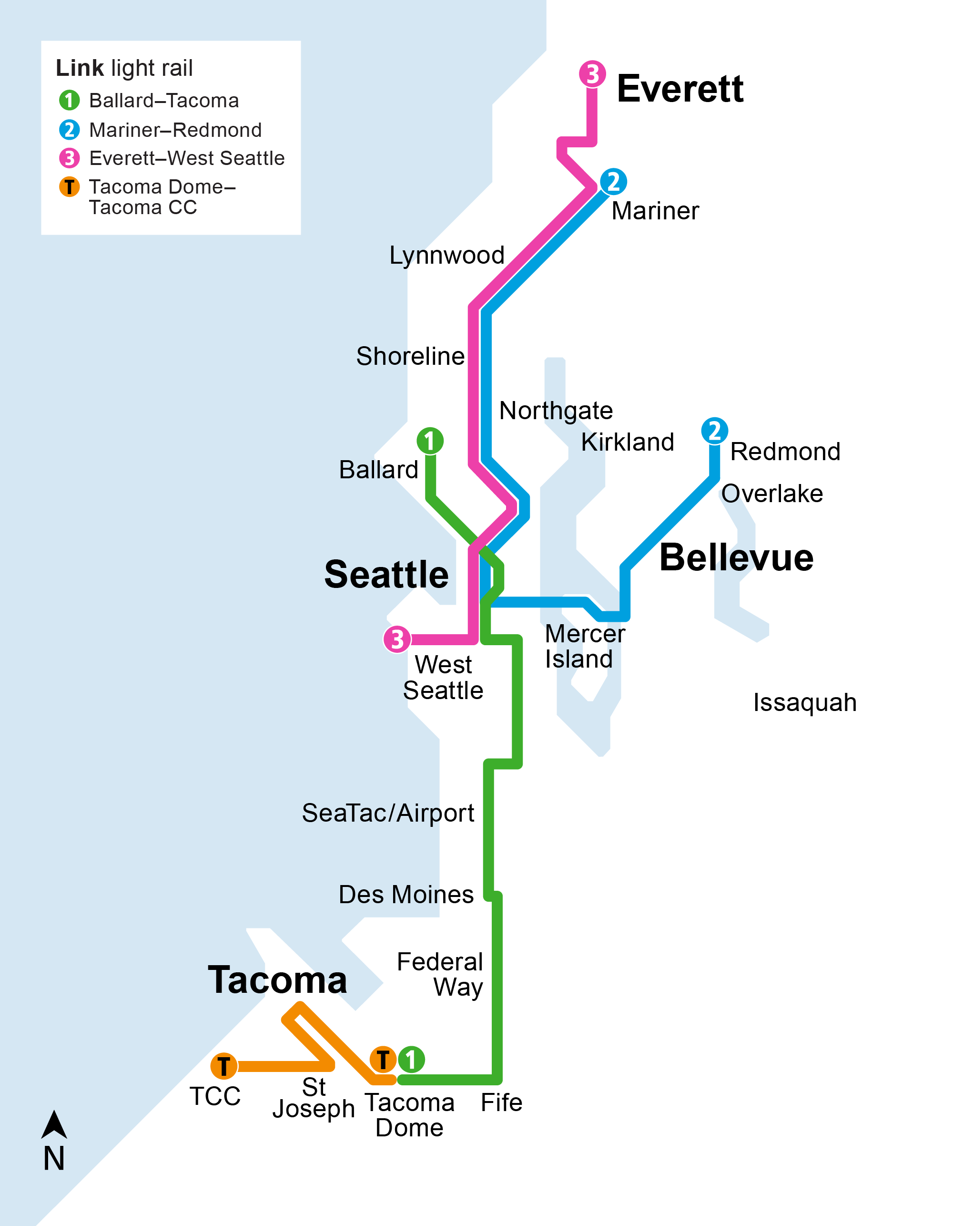
2041
Link light rail
  3 Line service extends north to Everett.
  T Line service adds six more stations and connects to Tacoma Community College.

Slide 26
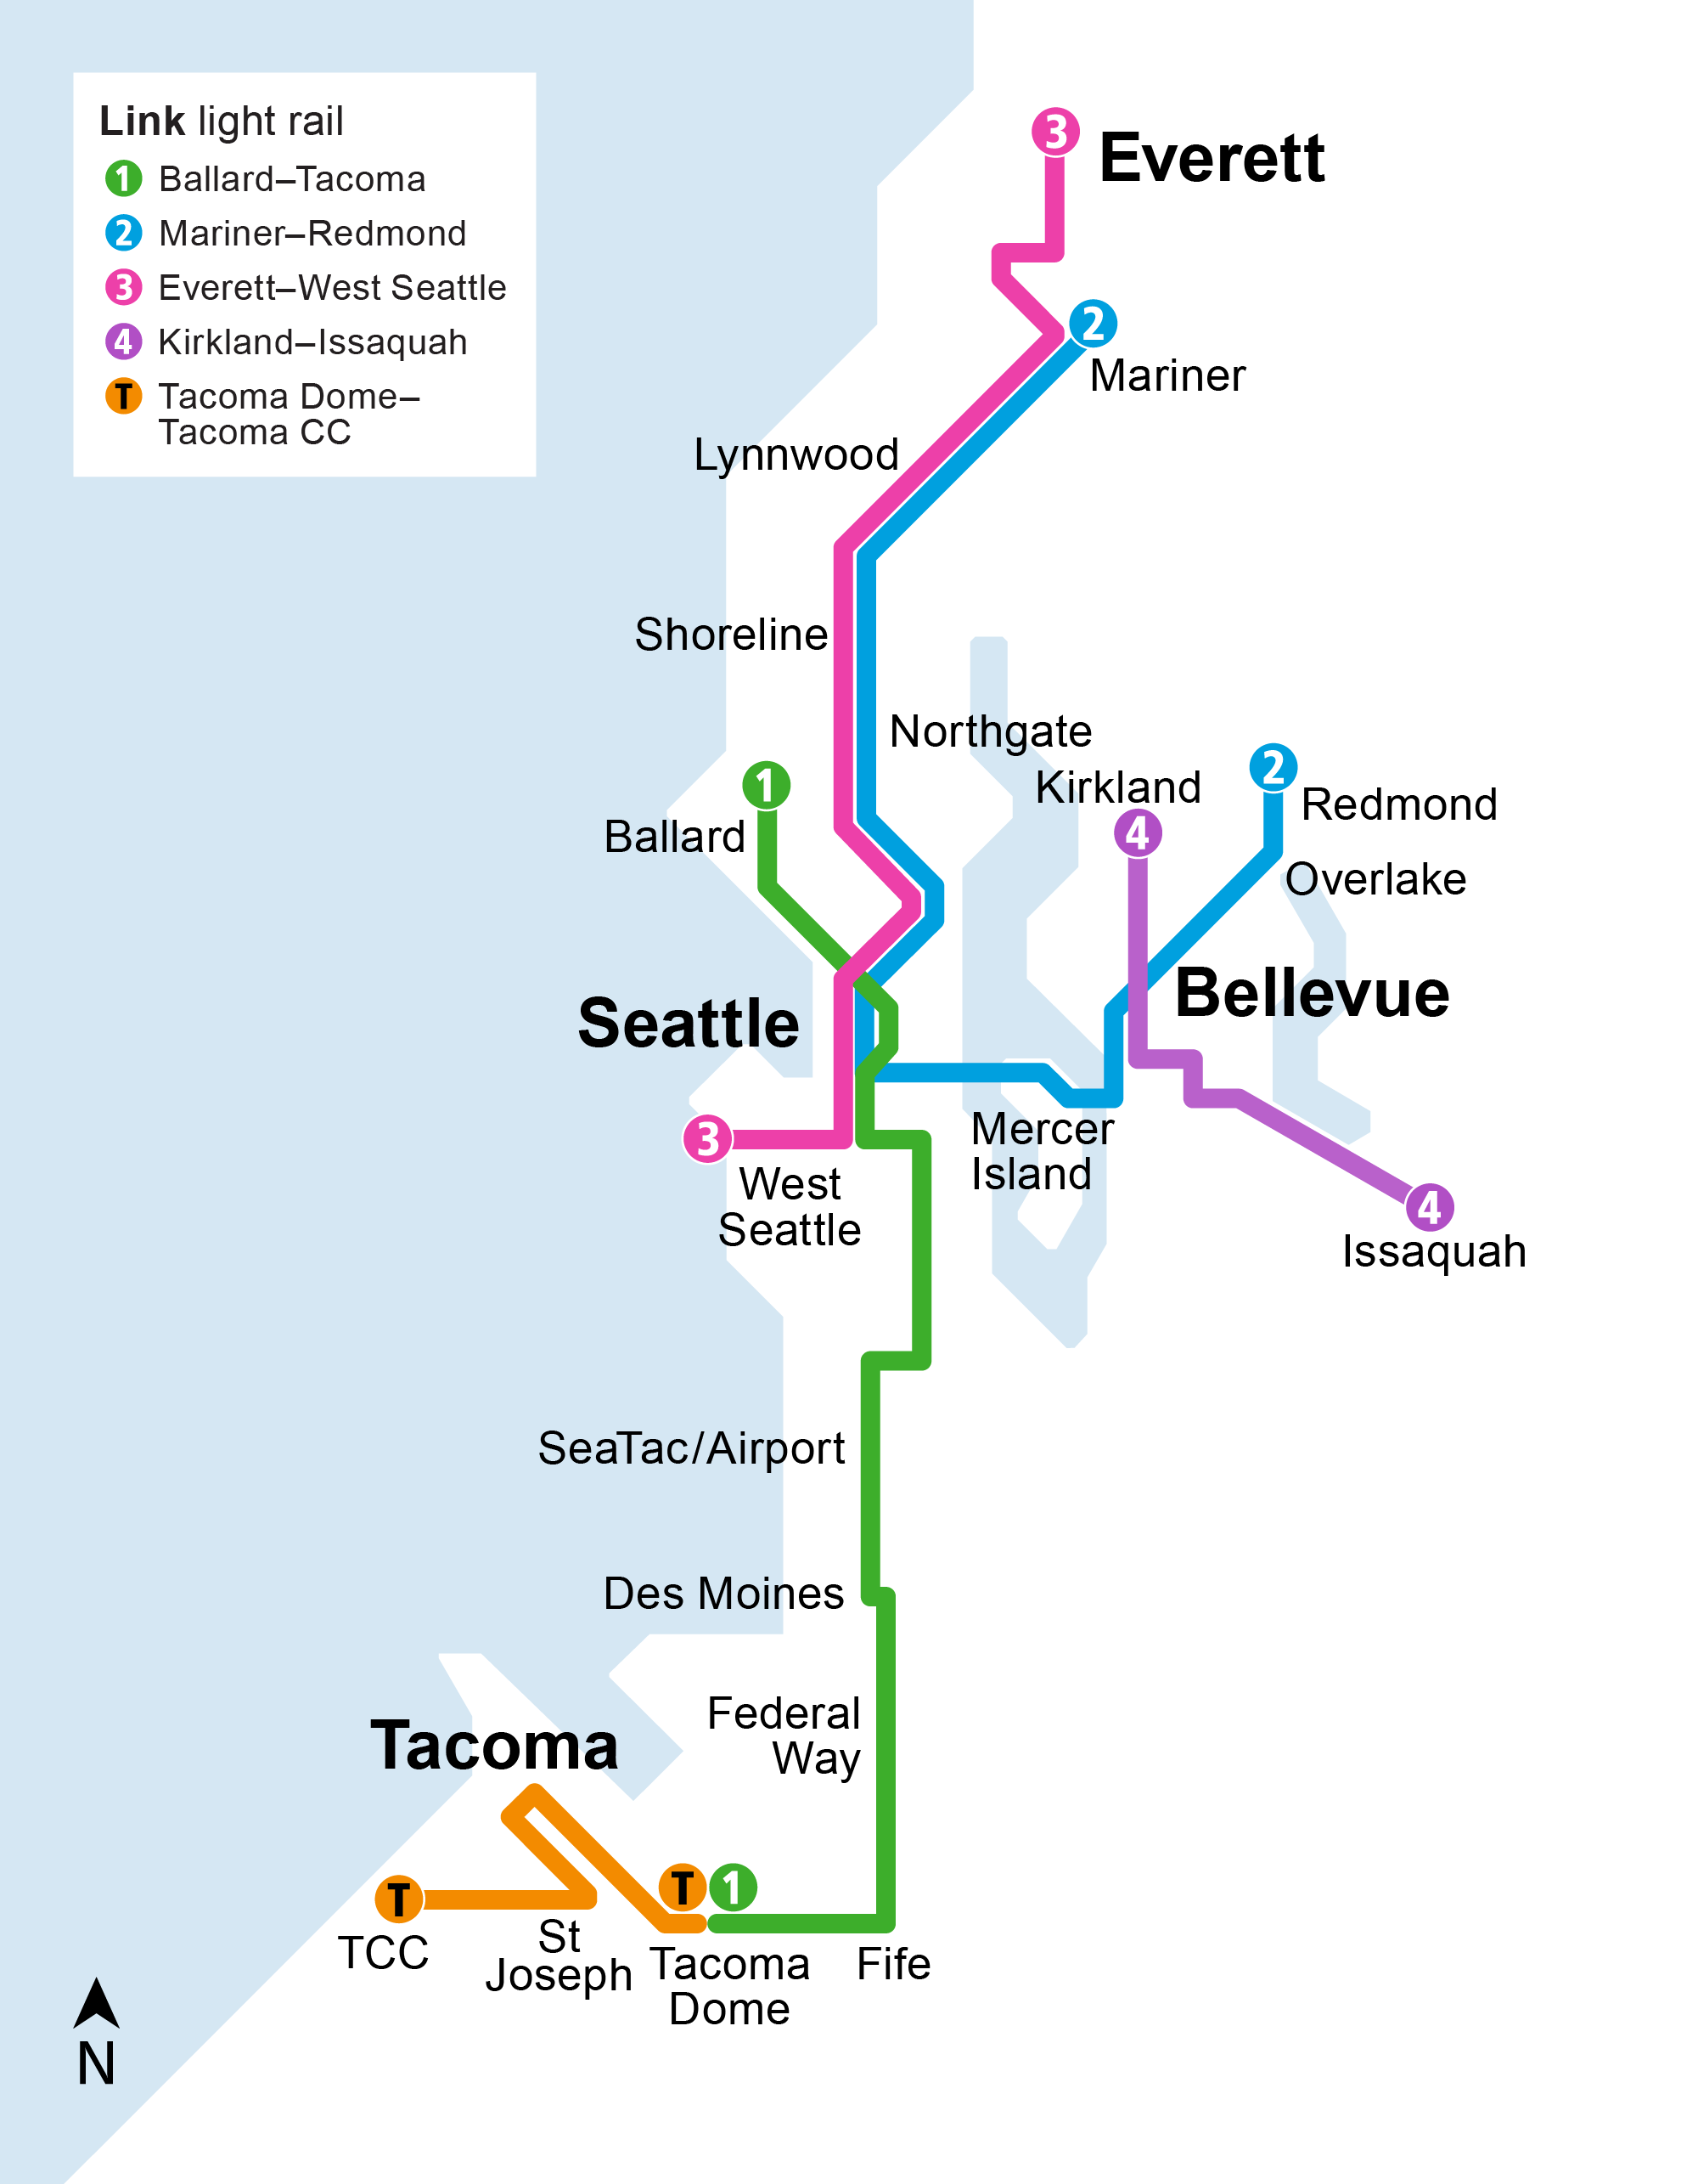
2044
Link light rail
  The 4 Line opens from South Kirkland to Issaquah with four new stations and 2 Line connections through downtown Bellevue.

Slide 27
Stride system maps
(service opening sequence)

Slide 28
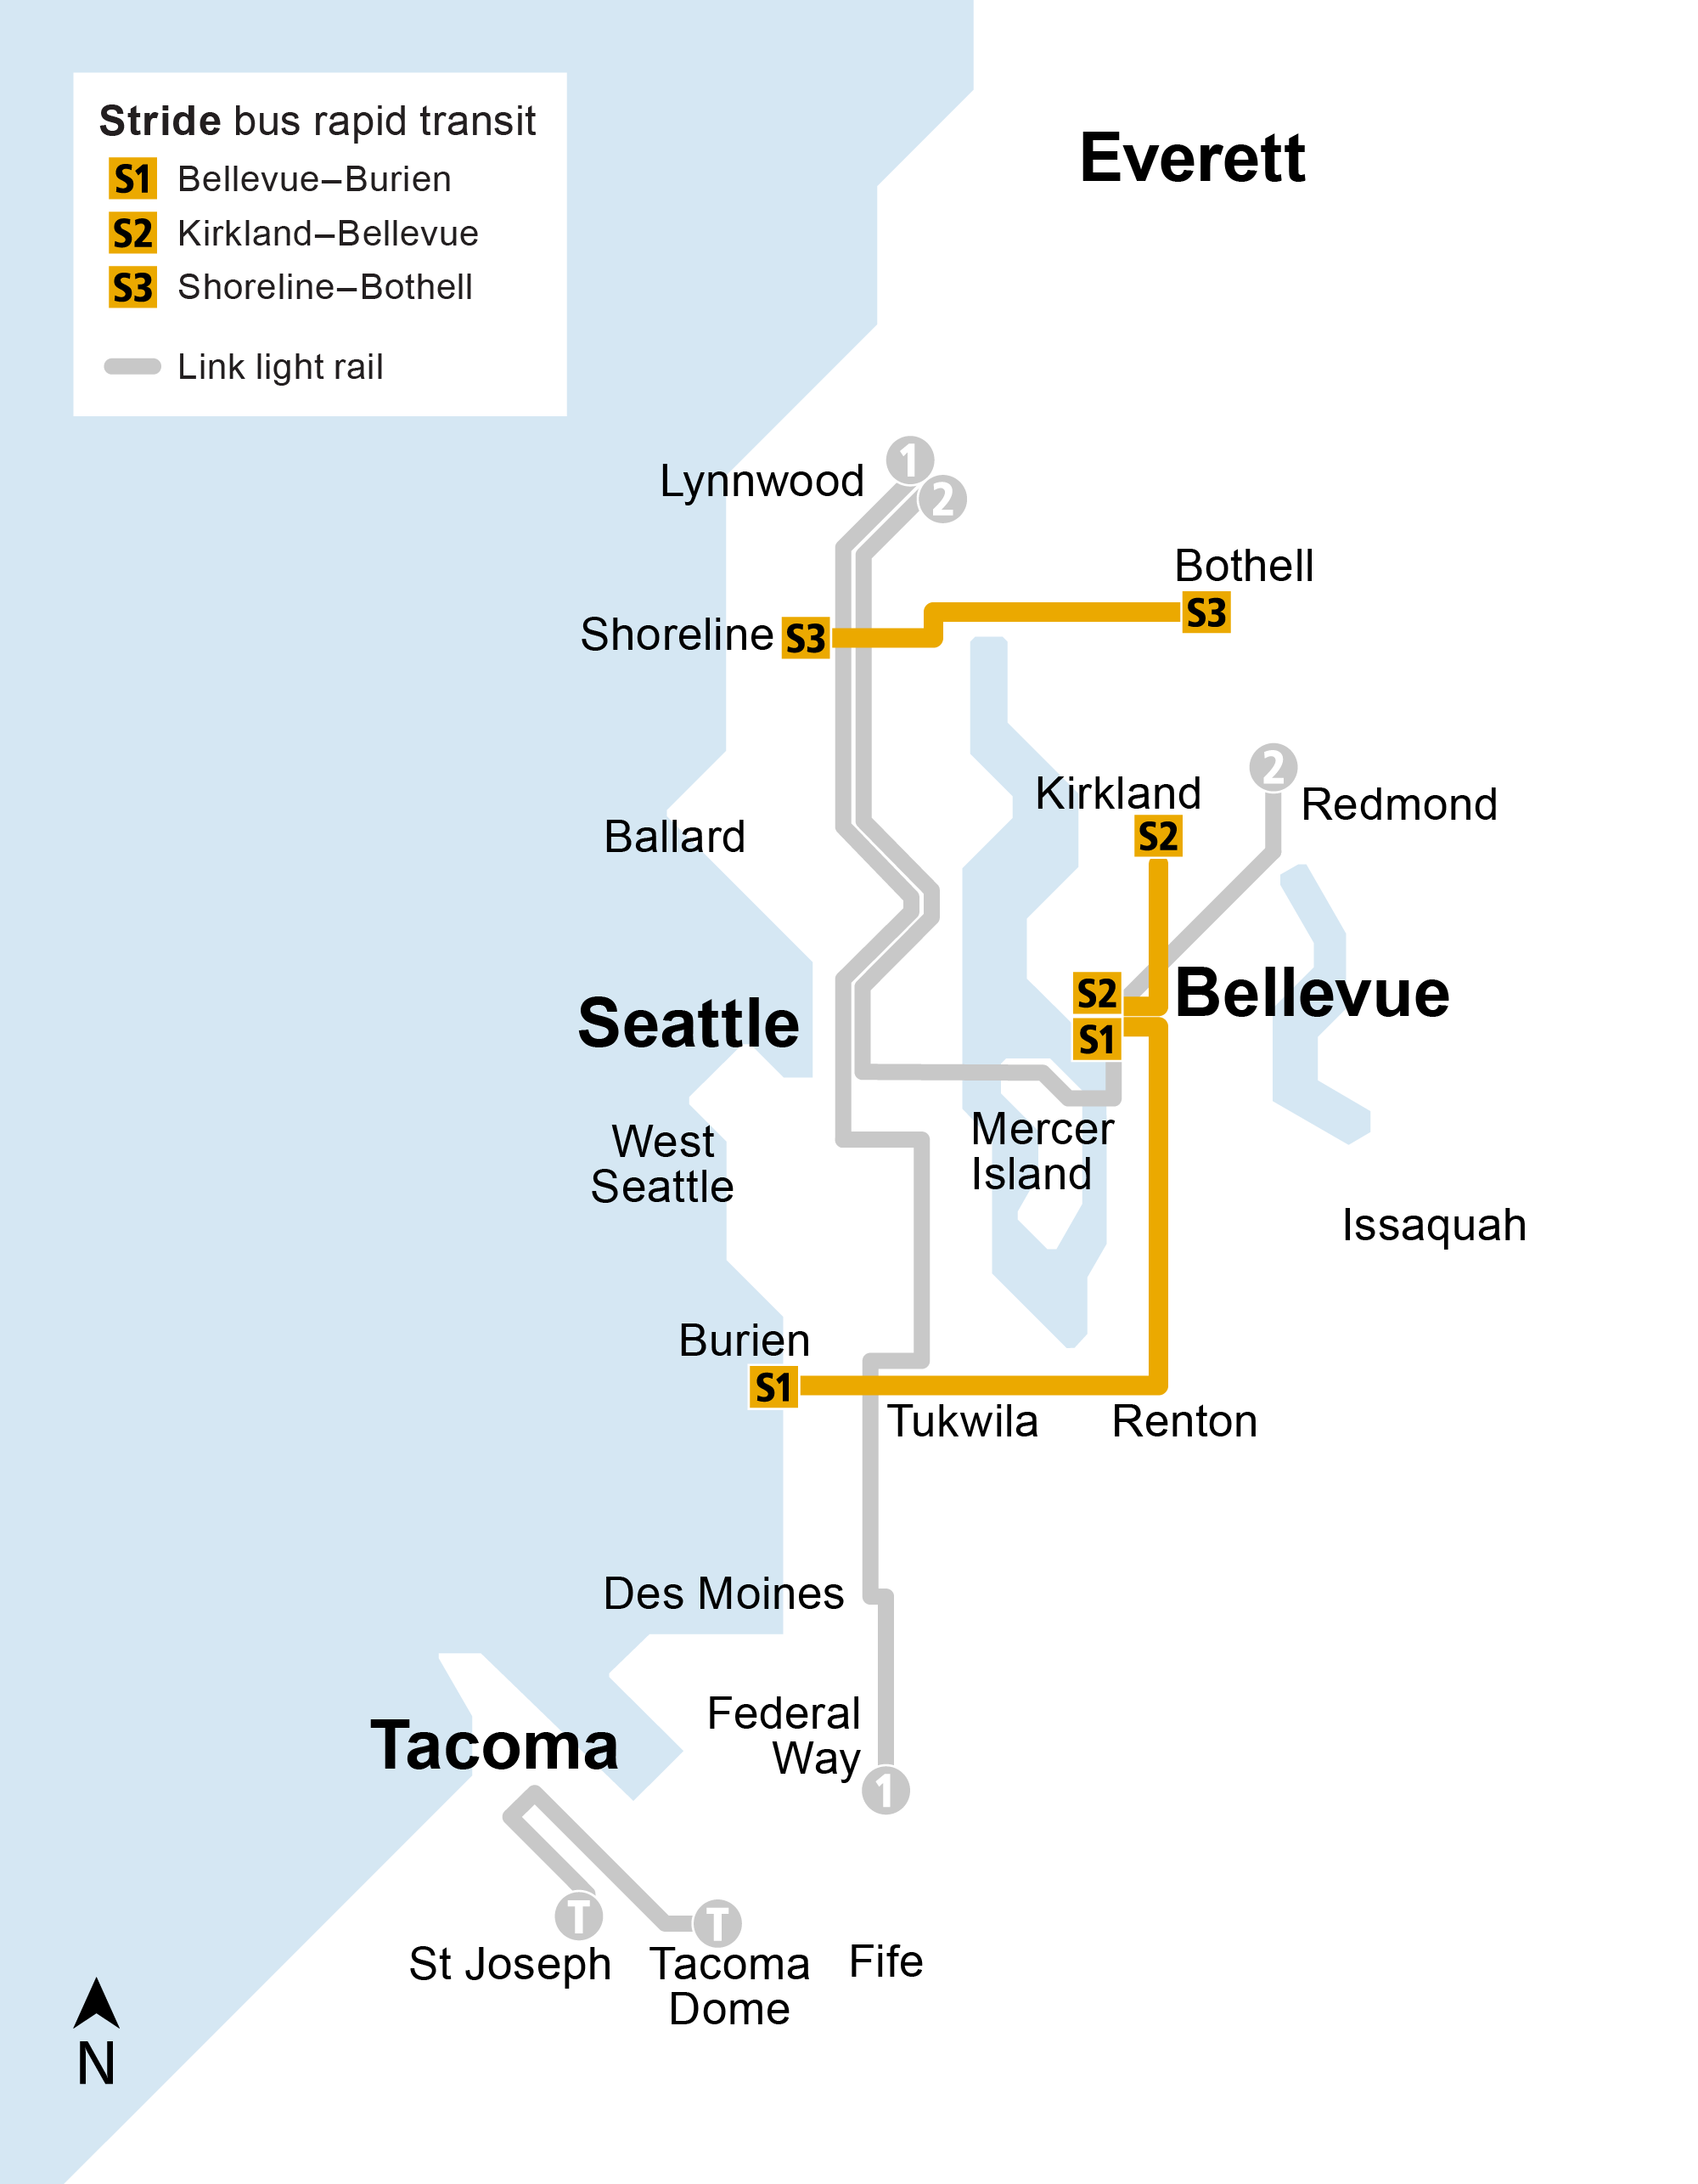
2028
Stride bus rapid transit
  S1 Line launches on I-405, serving Bellevue to Burien and connecting to light rail at Bellevue Downtown and Tukwila International Blvd stations.
  Partial S2 Line service opens between NE 85th Street in Kirkland and downtown Bellevue.
  S3 Line opens, serving communities along SR 522 between Shoreline and Bothell and connecting to light rail at Shoreline South/148th Station.

Slide 29
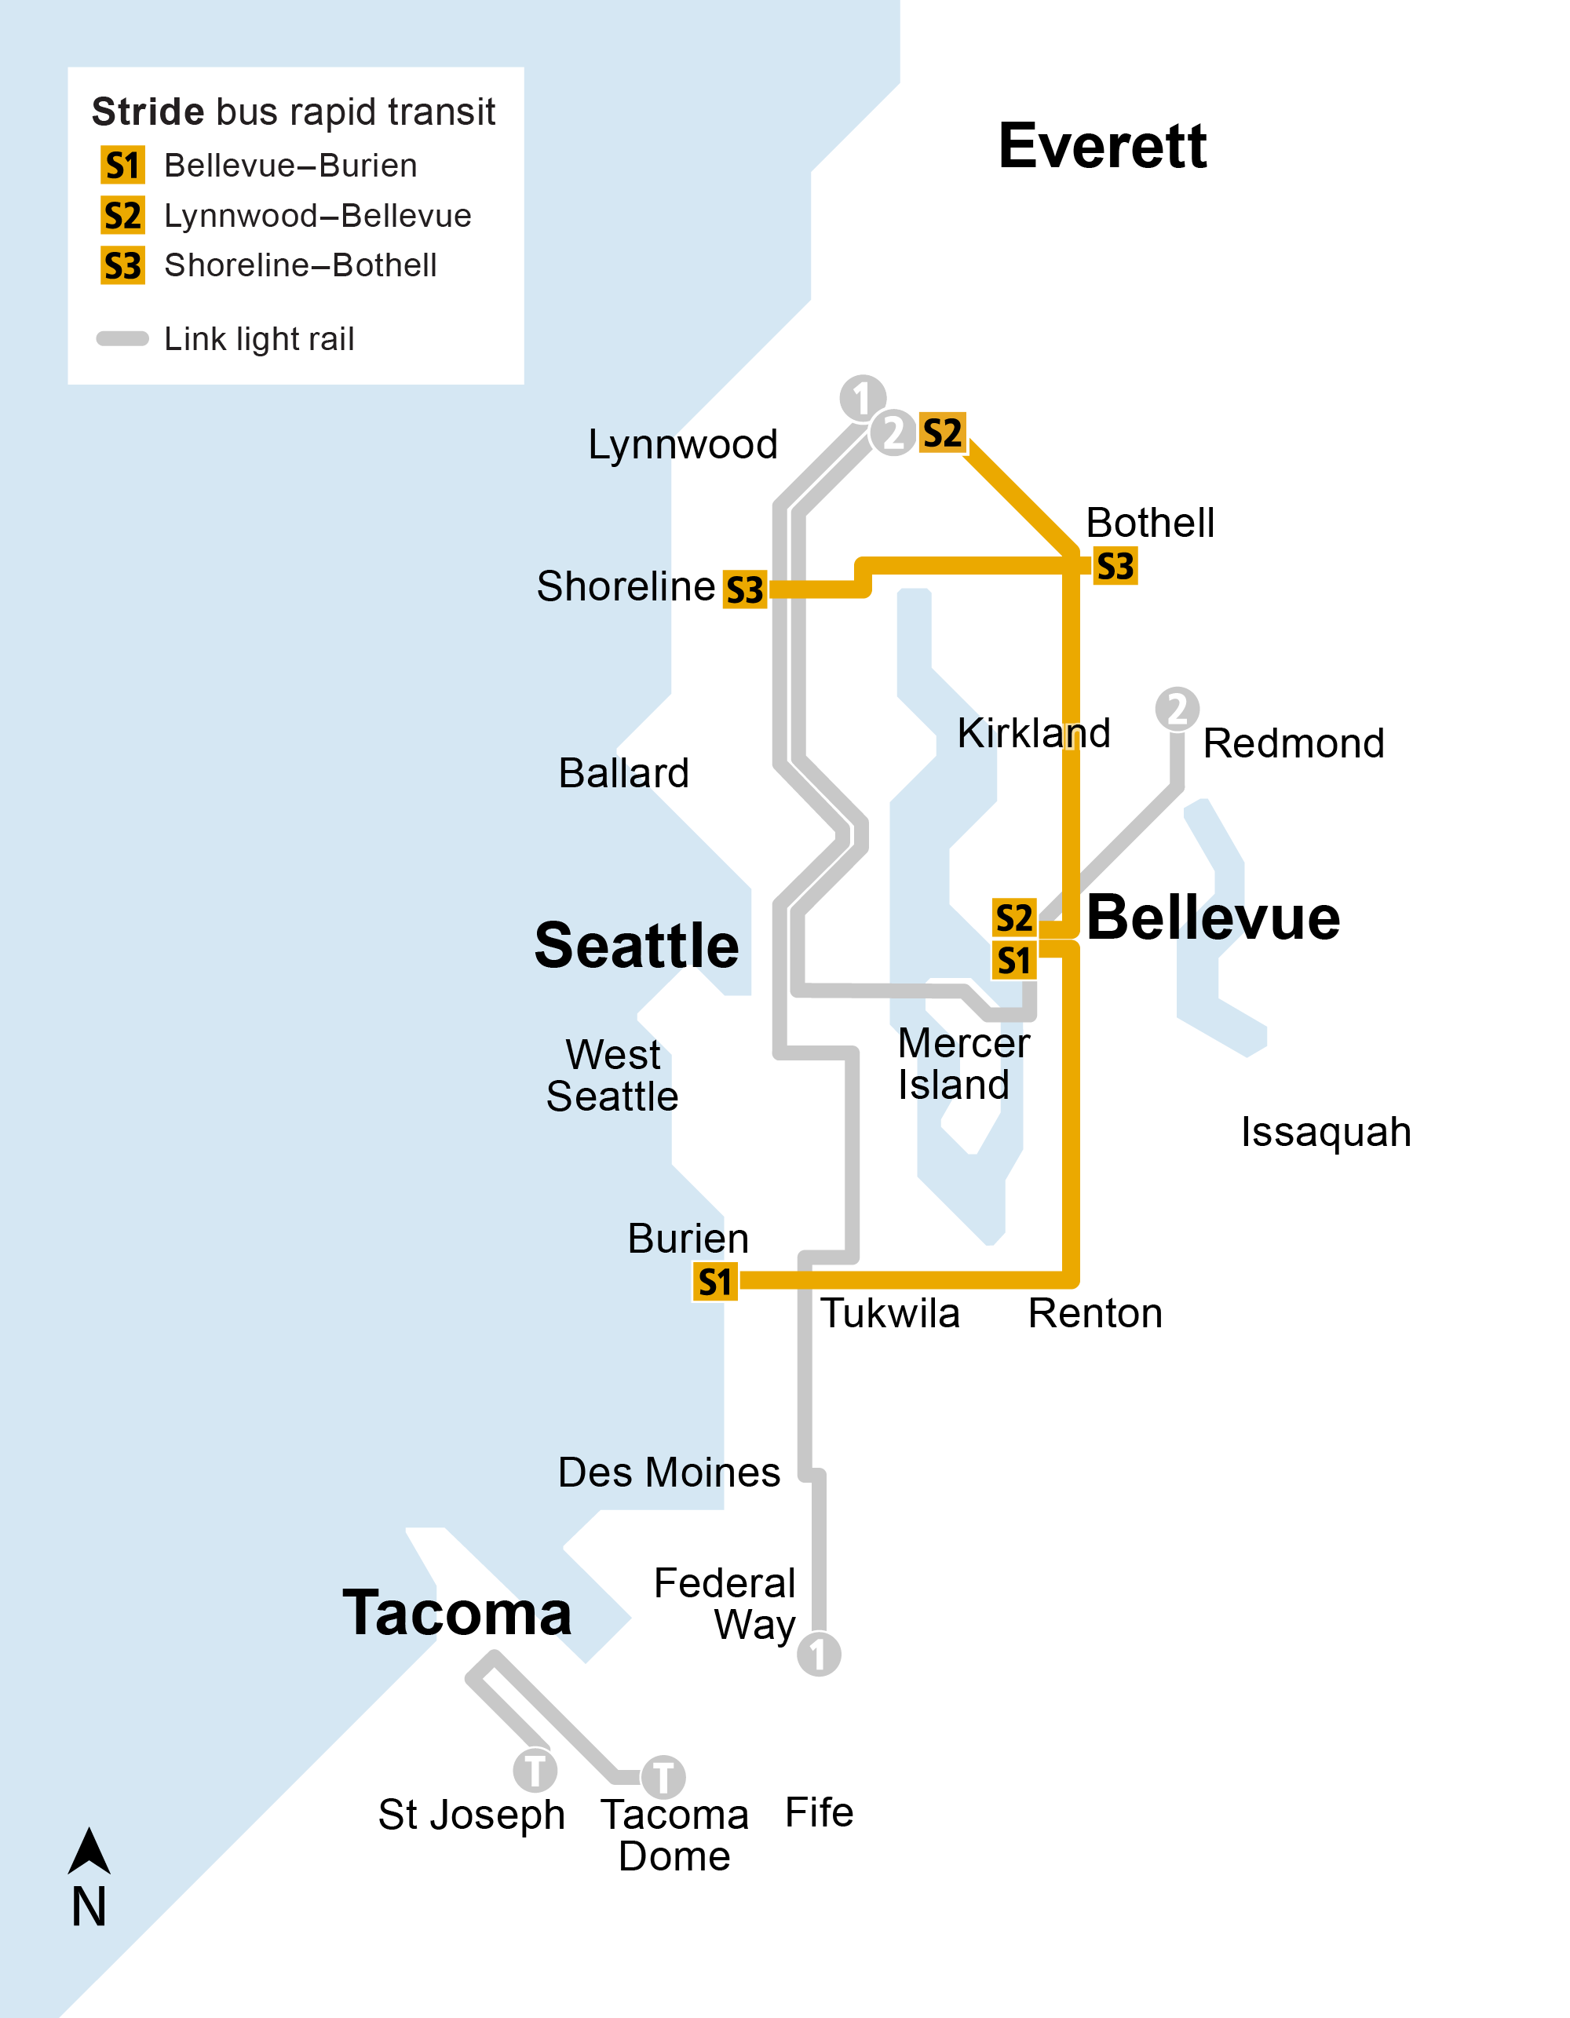
2029
Stride bus rapid transit
  The S2 Line extends north on I-405 to Lynnwood, connecting to the S3 Line in Bothell and light rail service at Lynnwood City Center Station.

Slide 30
More map options

Slide 31
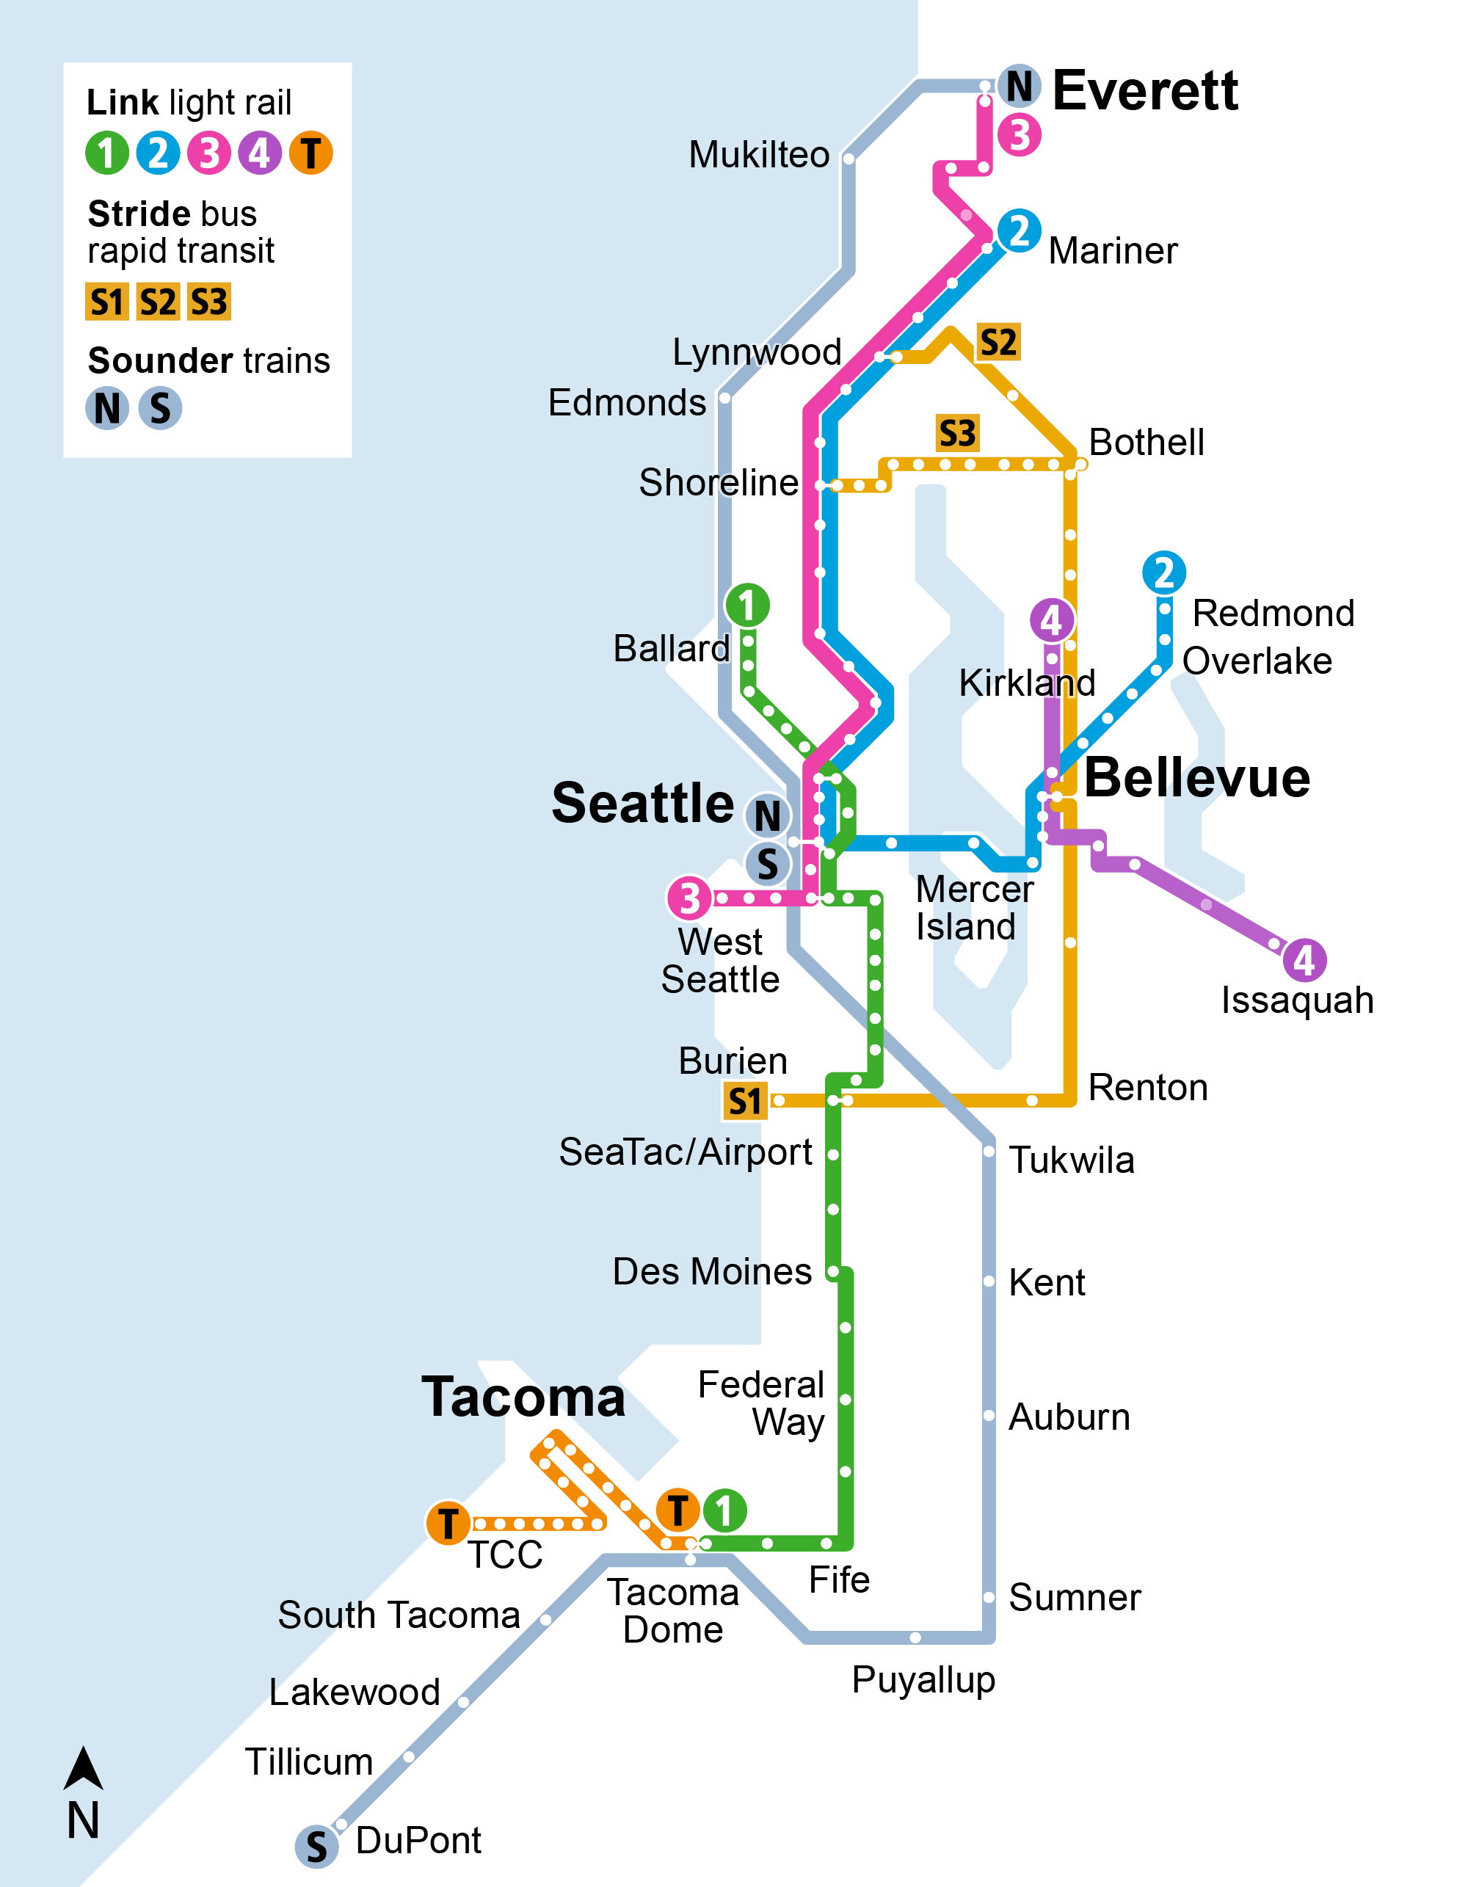
Voter-approved system
Link light rail
  Five lines
  116 miles
  83 stations
Sounder trains
Two lines
91 miles
14 stations
Stride bus rapid transit
  Three lines
  45 miles on I-405 and SR 522
  Serving 12 cities and connecting to light rail in Shoreline, Lynnwood, Bellevue, and Tukwila.
Includes stations.
Delete this text box
before use.

Slide 32
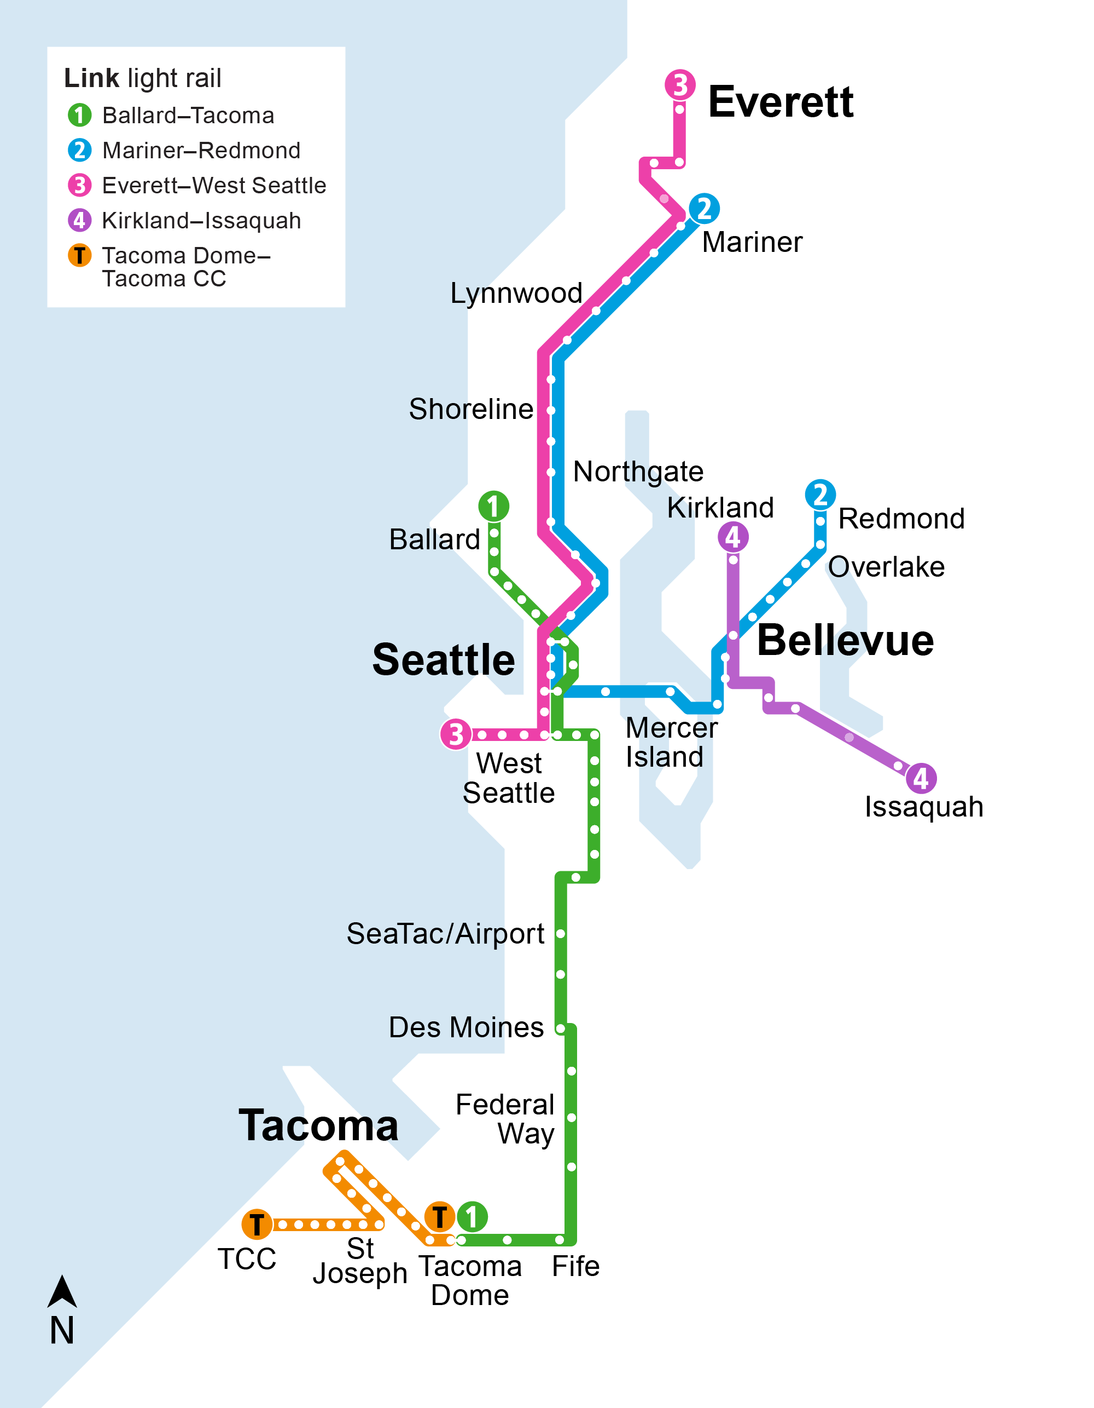
Voter-approved system
Link light rail
  Five lines
  116 miles
  83 stations
Includes stations.
Delete this text box
before use.

Slide 33
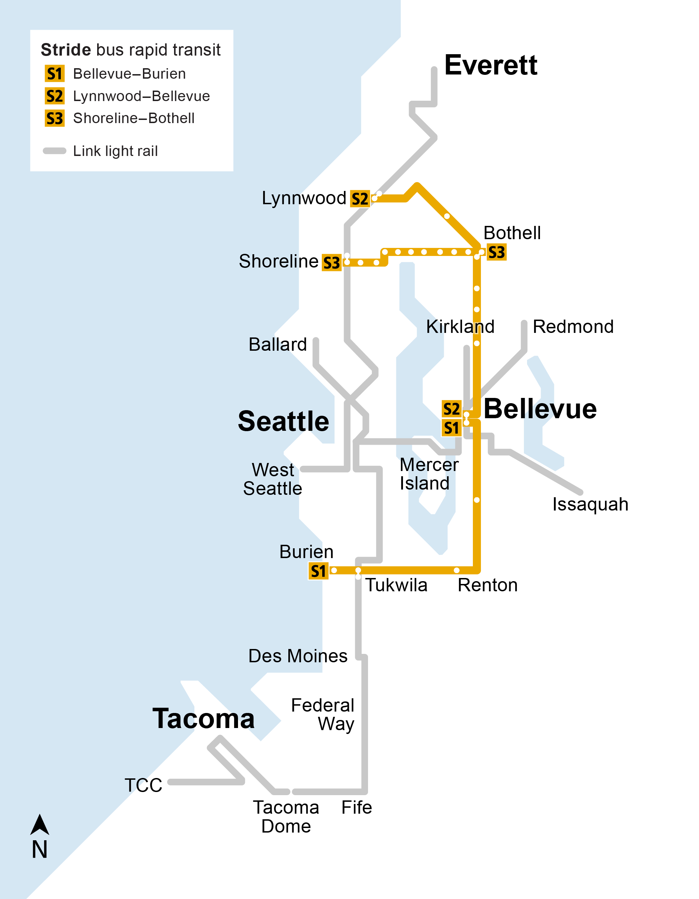
Voter-approved system
Stride bus rapid transit
  Three lines
  45 miles on I-405 and SR 522
  Serving 12 cities and connecting to light rail in Shoreline, Lynnwood, Bellevue, and Tukwila.
Includes stations.
Delete this text box
before use.

Slide 34
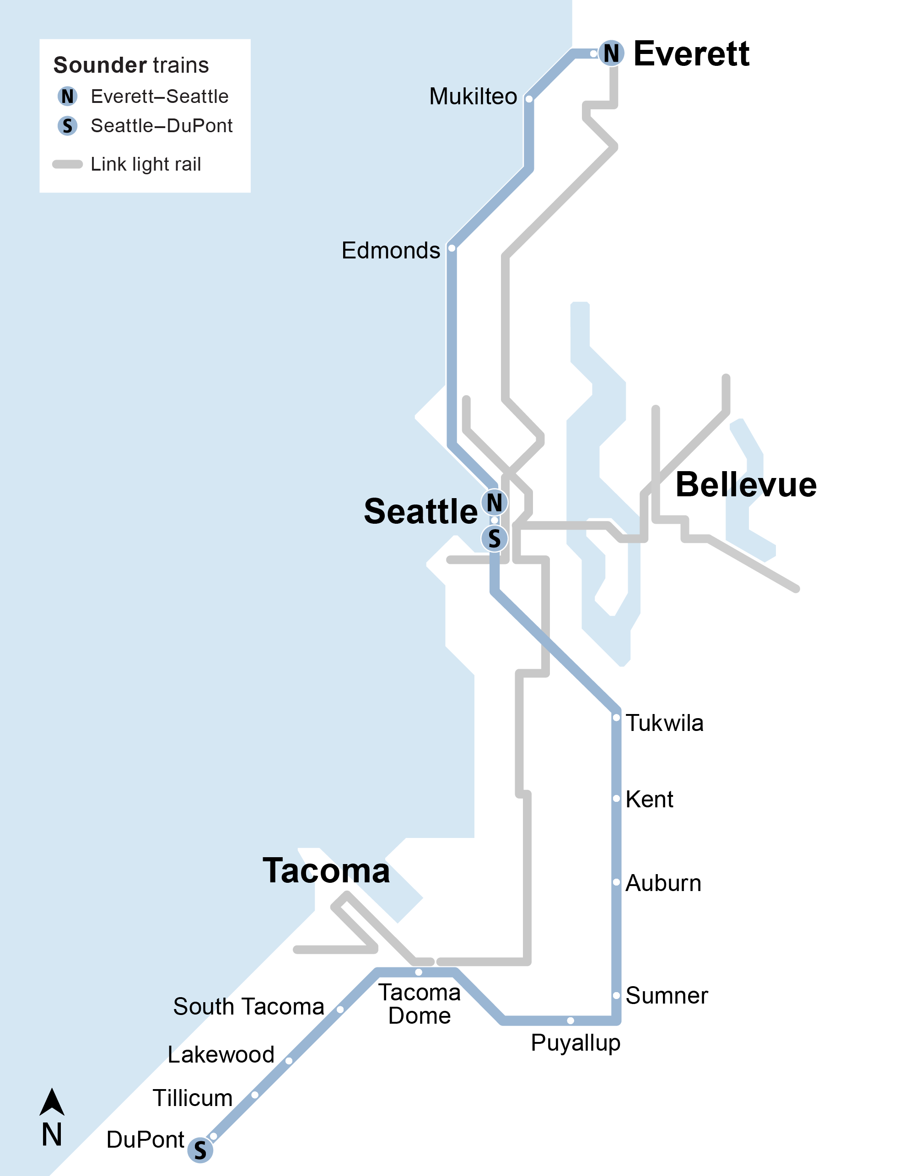
Voter-approved system
Sounder trains
Two lines
91 miles
14 stations
Includes stations.
Delete this text box
before use.

Slide 35
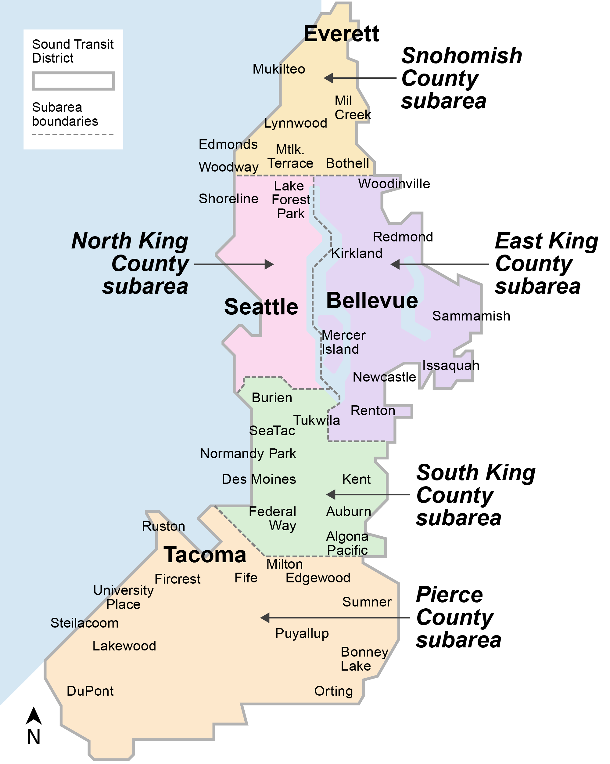
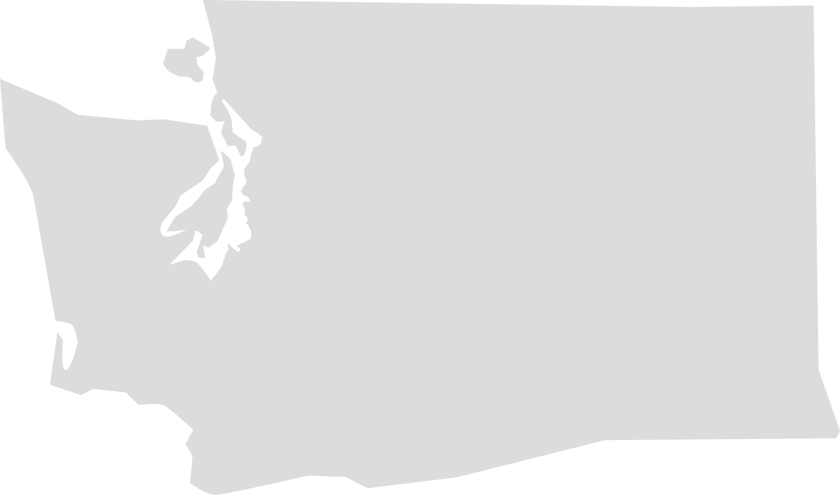
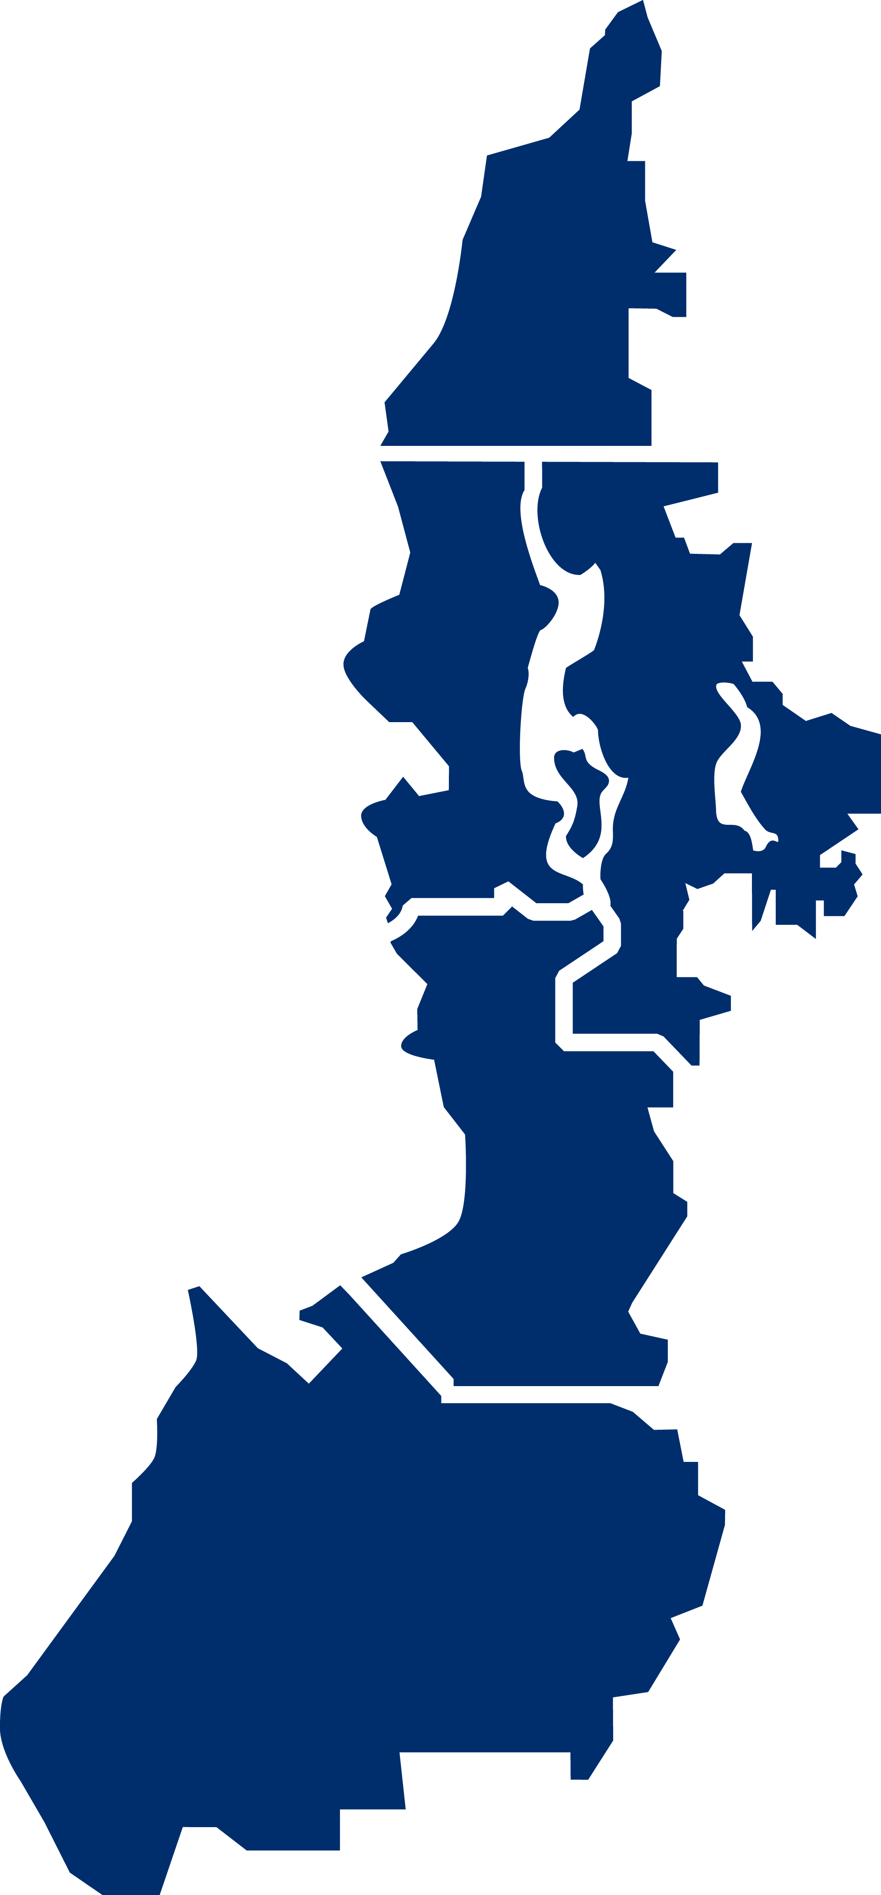
Sound Transit District
Serving a region of more than 3 million
40% of
the state’s population

Slide 36
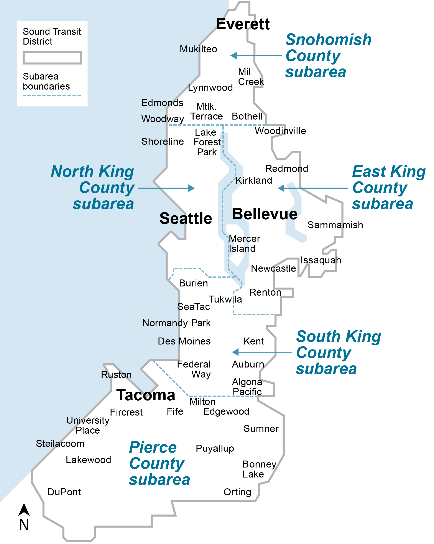
Sound Transit District
Serving a region of more than 3 million
40% of
the state’s population

