Slide 1




Exit Conference
Central Puget Sound Regional Transit Authority
Sound Transit
Joseph Simmons
Program Manager
Eileen Du
Audit Supervisor
Daniel Thompson
Audit Lead
December 15, 2022

Slide 2
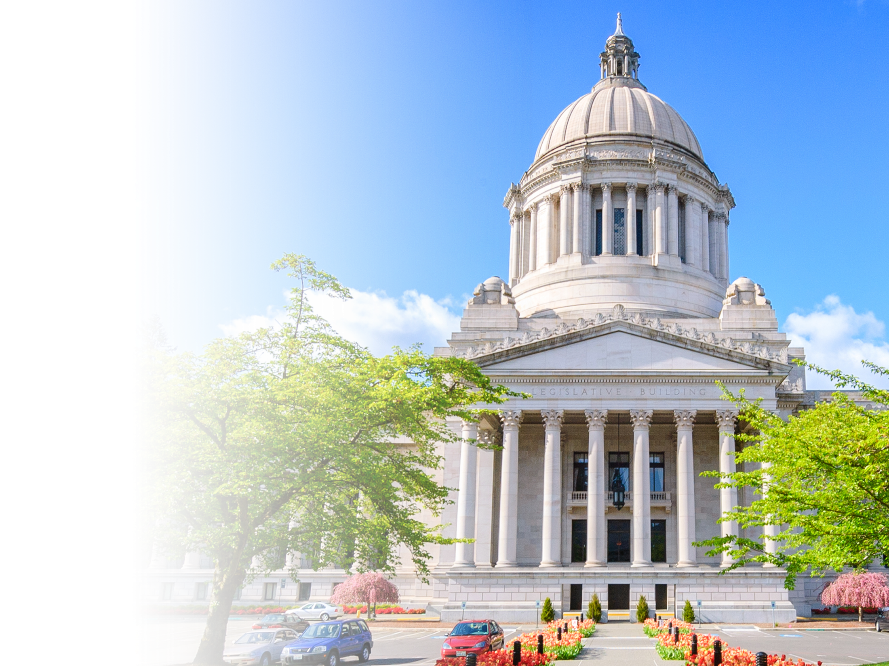

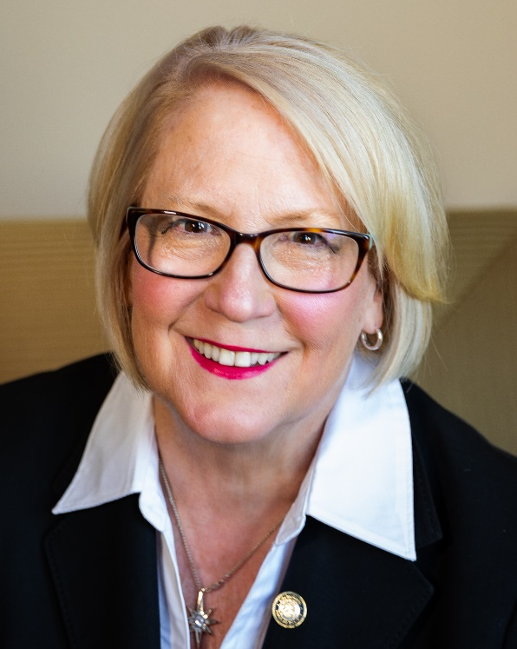


Results that Matter
Increased trust in government
Independent, transparent examinations
Improved efficiency and
effectiveness of government
Pat McCarthy
State Auditor

Slide 3

Accountability Audit Results
January 1, 2021 through December 31, 2021
Results in Brief
This report describes the overall results and conclusions for the areas we examined.
In those selected areas, the Authority’s operations complied, in all material respects, with applicable state laws, regulations, and its own policies, and provided adequate controls over the safeguarding of public resources.
In keeping with general auditing practices, we do not examine every transaction, activity, policy, internal control, or area. As a result, no information is provided on the areas that were not examined.

Slide 4
Accountability Audit Results
Using a risk-based audit approach, for the Authority, we examined the following areas during the period:
Small and attractive assets – new policies and procedures
Expenditure testing – credit cards and general disbursements
Procurement – compliance with policies over request for proposals (RFP) contracts
Open public meetings – compliance with minutes, meetings and executive session requirements
Financial condition – reviewing for indications of financial distress

Slide 5

Related Audit Work
January 1, 2021 through December 31, 2021
Audit Type: Financial and Federal
Review of Independent CPA firm Audit

Slide 6

Work of Other Auditors
A financial statement and federal grant audit was performed by Moss Adams of Sound Transit.
We did not find anything about their work that caused concern about its quality.
No limitations restricted our analysis of the other audits.
Did not notice any instance in which a material misstatement of the financial statements has or may have resulted from fraud or suspected fraud.

Slide 7

Closing Remarks
Audit costs are in alignment with our original estimate
Next audit: fall of 2023
  Accountability for public resources
  An estimated cost for the next audit has been provided in our exit packet

Slide 8
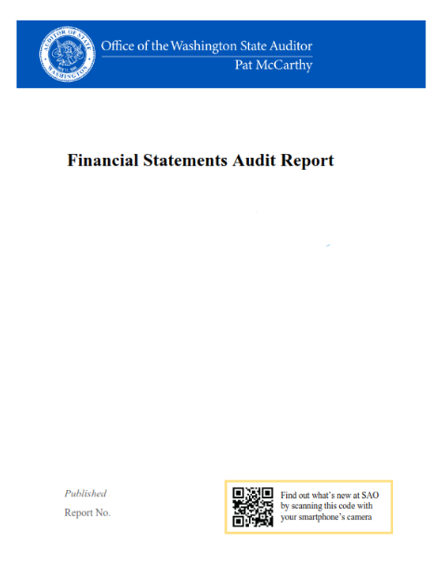
Report Publication
  Audit reports are published on our website.
  Sign up to be notified by email when audit reports are posted to our website:
  https://sao.wa.gov/about- sao/sign-up-for-news-alerts/
  Audit Survey
  When your report is released, you will receive an audit survey from us.
  We value your opinions on our
  audit services and hope you
  provide feedback.

Slide 9

Thank You!
We thank the Authority officials and staff for timely communications throughout the audit process.
In particular, we would like to thank Lori Bevier, Audit Liaison, for her work ensuring the efficiency of the audit process.

Slide 10


Questions?
  Contact Joseph Simmons, Program Manager
  Joseph.Simmons@sao.wa.gov
  (206) 613-7628
10

